Slide 1
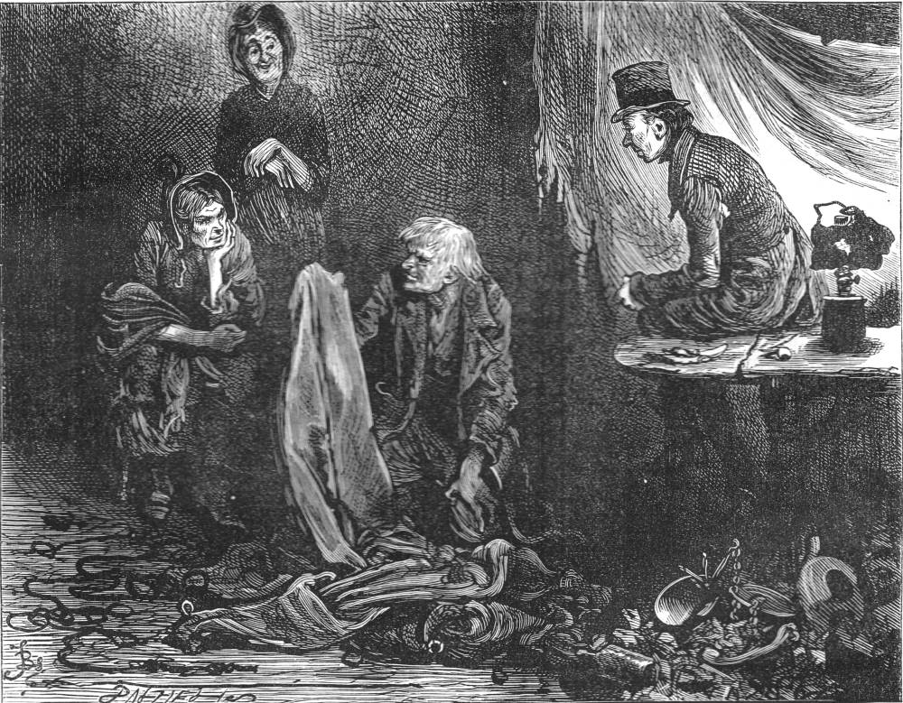
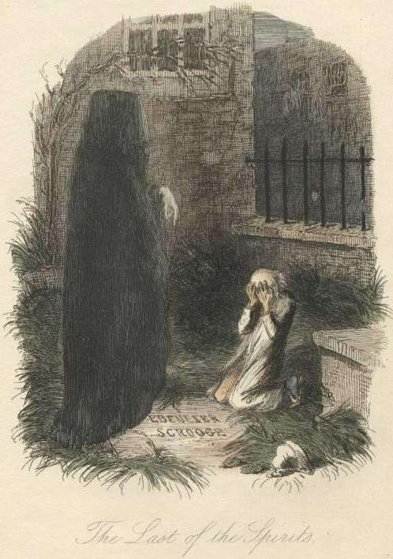
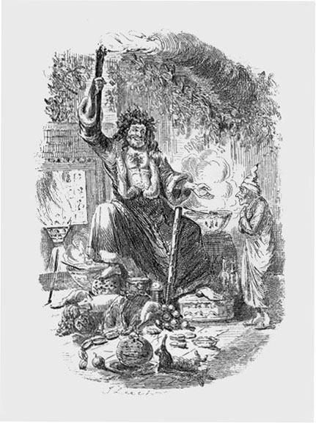
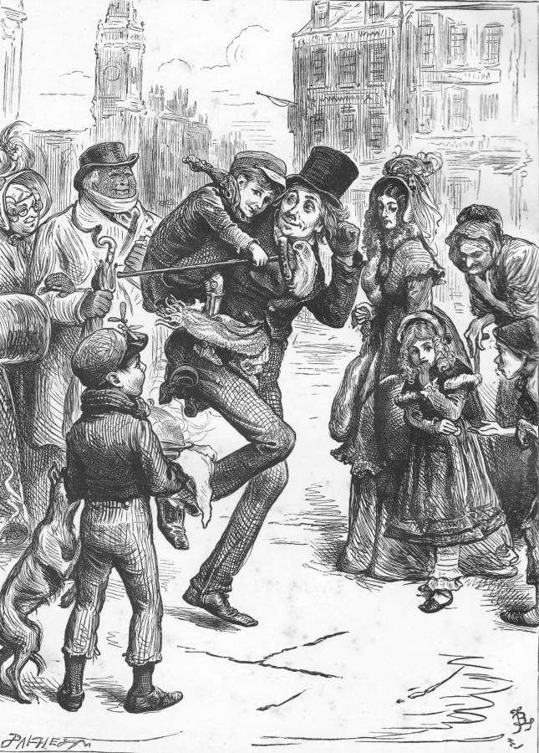
Starter Activity: A Christmas Carol
Look carefully at the original illustrations from the novella. What can you infer and deduce about
A) Scrooge
B) The Plot

Slide 2
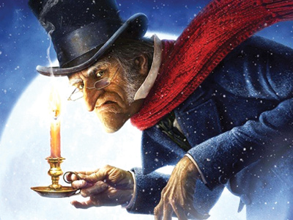
A Christmas Carol
Scrooge’s Characterisation

Slide 3
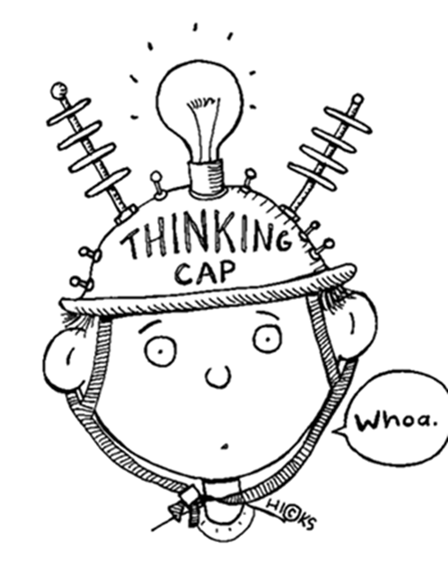
Learning Objectives
By the end of the lesson…
You will explore language and explain how Dickens creates Scrooge’s identity
You will gain knowledge of the assessment criteria and understand how to structure a written response

Slide 4
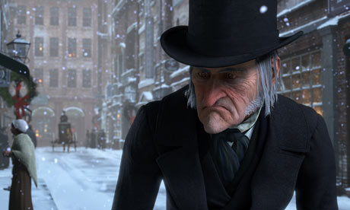
First Impressions
Dickens uses adjectives to describe Scrooge. What do we learn about him?
“Oh! But he was a tight-fisted hand at the grindstone. Scrooge! A squeezing, wrenching, grasping, scraping, clutching, covetous, old sinner!”
Glossary:
gait-way of walking
frosty rime- white hair
covetous-envious of other people’s possessions
Is it considered skilful writing to use many adjectives in a single sentence? Why has Dickens made this choice?

Slide 5
Describing Scrooge
Oh! But he was a tight-fisted hand at the grindstone, Scrooge! a squeezing, wrenching, grasping, scraping, clutching, covetous, old sinner! Hard and sharp as flint, from which no steel had ever struck out generous fire; secret, and self-contained, and solitary as an oyster. The cold within him froze his old features, nipped his pointed nose, shriveled his cheek, stiffened his gait; made his eyes red, his thin lips blue and spoke out shrewdly in his grating voice.
Read Dickens’ description of Scrooge. Select words and phrases that reveal his character.

Slide 6
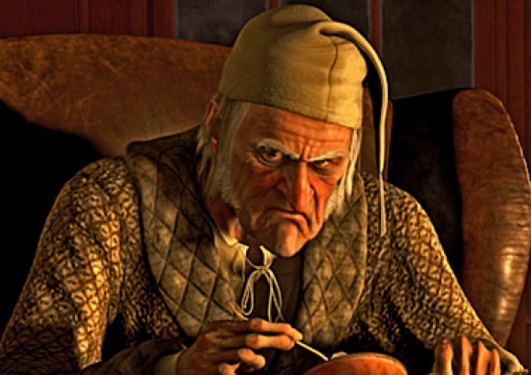
Ebenezer Scrooge
Adjective | Evidence
Miserable
What are your first impressions of Ebenezer Scrooge?
Write down 5 adjectives that describe Scrooge then find an example of something that Scrooge says or does which reinforces that idea.

Slide 7
Scrooge: possible answers
Envious- “a covetous old sinner”
Miserly- “he was tight-fisted”
Unkind/mean spirited- “hard and sharp as flint”
Unsociable- “self- contained, and solitary as an oyster”, “sole”
Selfish- “I” , “My”
Unsympathetic- “warning all human sympathy to keep its distance”
Obsessed with work- “old Scrooge sat busy in the counting house”
Uncaring/indifferent- “the cold within him froze his features”
Short-tempered- “Scrooge walked out with a growl”
Cynical- “Bah! Humbug!”
Disliked/menacing- “nobody ever stopped him in the street”

Slide 8
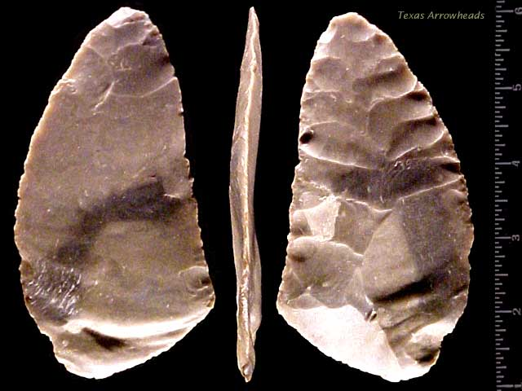
“hard and sharp as flint”
What do we learn about Scrooge from this simile?
sharp & can cut grey/old
used for ………
feels ………
Type of ……….

Slide 9
“hard and sharp as flint”
What do we learn about Scrooge from this simile?
sharp & can cut grey/old
used for
lighting fires
and as weapons
feels hard/rough
Type of Quartz

Slide 10
How do I write about Scrooge in the exam?
Scrooge is miser, who sinfully takes advantage of the poor. He is described as “Hard and sharp as flint” at the beginning of stave one. The simile is used to suggest that he is both intelligent and dangerous as he is “sharp”. His job as a creditor means he possesses both qualities and uses them to take advantage of the poor. The “hard” quality of the flint links to Scrooge’s unrelenting and harsh attitude to other people as he enjoys being alone. “Flint” can creates sparks that will produce a fire. In the novella, fire is symbolic of the Christmas spirit and although Scrooge is currently evil, he will change as the ghosts intervene to save his soul.
Point
Evidence
Explanation
Historical Context

Slide 11
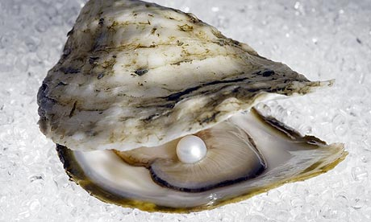
“solitary as an oyster”
What do we learn about Scrooge from this simile?
Doesn’t have anything to do with anything else
Can be worth
a lot of ……… hard shell
Found in …….. Considered a ……..

Slide 12
“solitary as an oyster”
What do we learn about Scrooge from this simile?
Doesn’t have anything to do with anything else
Can be worth
a lot of money hard shell
Found in the sea bed Considered a delicacy

Slide 13
Plenary Activity: “solitary as an oyster”
In your exercise books, write a paragraph that explores the above quotation.
Structure your response as follows:
Point: one sentence; a clear idea about Scrooge’s personality.
Evidence: one sentence; embed the quotation.
Explanation: a detailed analysis that explores individual words (add layers of meaning).
Historical context: add information that shows you understand the relationship between the novella and the Victorian era.

Slide 14
Starter Activity: Textual Analysis
“The door of Scrooge's counting-house was open that he might keep his eye upon his clerk, who in a dismal little cell beyond, a sort of tank, was copying letters. Scrooge had a very small fire, but the clerk's fire was so very much smaller that it looked like one coal. But he couldn't replenish it, for Scrooge kept the coal-box in his own room…”
1. What do we learn about the relationship between Scrooge and his clerk (Bob Cratchit)?
2. What do we learn about their social positions?
3. Why make reference to fire? Can this be related back to last lesson’s extracts?

Slide 15
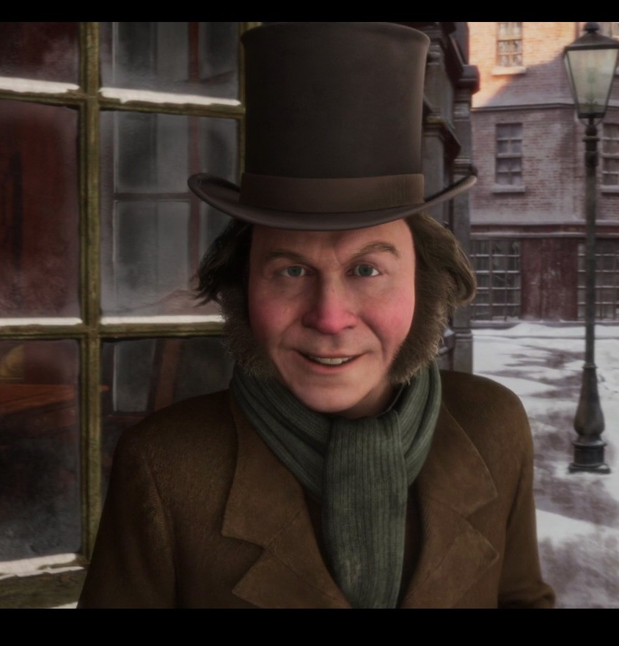
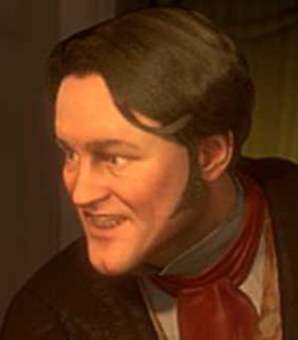
A Christmas Carol
The Clerk (Bob) & The Nephew (Fred)

Slide 16
Learning Objectives
By the end of the lesson…
You will explore language and explain how Dickens contrasts Scrooge with Fred/Bob
You will gain some insight into Dickens’ background (Historical Context)

Slide 17
Task: Comparative Table
As we read the chapter, complete a comparative table in your exercise book, in which you compare Scrooge, Fred and Bob.
Scrooge | Bob | Fred
Scrooge is cynical about Christmas and other people: “Bah Humbug!” | Bob is similar to Fred in his Christmas spirit, and refuses to be completely oppressed by Scrooge: “The clerk in the tank involuntarily applauded.” | Fred contrasts Scrooge as he loves Christmas, God and even his uncle: “A merry Christmas, uncle! God save you!”

Slide 18
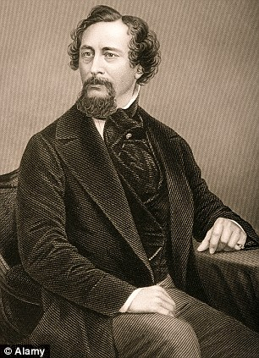
Task: Historical Context
We are going to watch a short video about the life of Charles Dickens. This will help to develop your understanding of the novella and you will need to include this information in all future essays.
Make notes in the back of your book. How does this information influence your thoughts about A Christmas Carol?
http://www.youtube.com/watch?v=3AB9poWDeDs

Slide 19
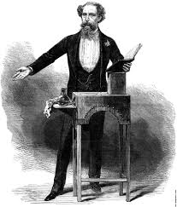
Historical Context Information
Although initially wealthy, John Dickens fell into debt and was sent to Marshalsea Prison
The Dickens family then moved to a poor area of London
He worked labelling blacking-bottles to help his family
He trained as a law clerk and then a journalist
His novels have social messages and attempt to reform society
Early in 1843, as a response to a government report on the abuse of child labourers in mines and factories, Dickens vowed he would strike a "sledge-hammer blow ... on behalf of the Poor Man's Child."
How can we relate each of these bullet points to the novella?

Slide 20
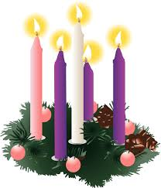
Plenary Activity: The Symbolism of Fire
Fire is a symbol of the Christmas spirit in the novella. It is a reoccurring motif throughout the story, and shows the transformation of Scrooge.
Scrooge (p.1): “The cold within him froze his old features.”
The Counting House fire (p.2): “Scrooge had a very small fire, but the clerk’s fire was so very much smaller it looked like one coal.”
Fred (p.2): “he was all aglow… his eyes sparkled… his breath smoked.”
Glossary
Symbolism: the use of symbols to represent ideas or qualities.
Motif: a pattern or recurring idea in an artistic work.
The four advent candles stand for hope, peace, love and joy. Scrooge must find these on his journey to redemption.

Slide 21





Starter Activity: Payday Loans
Think about the following:
What is a payday loan?
What group of people are they aimed at?
What problems are associated with them?
How do they relate to A Christmas Carol?

Slide 22
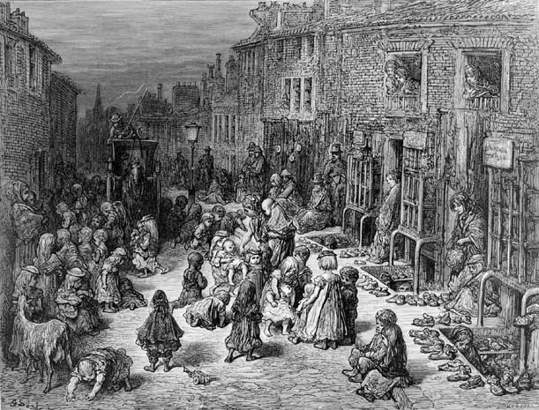
A Christmas Carol
The Suffering of the Victorian Poor

Slide 23
Learning Objectives
By the end of the lesson…
You will explore Scrooge’s attitude to the poor
You will gain some insight into Victorian society (Historical Context)

Slide 24
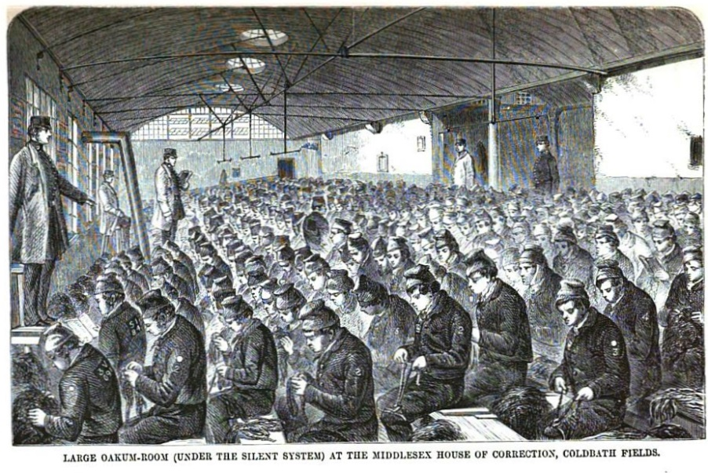
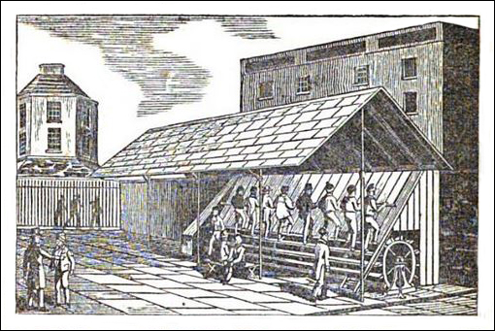
The Prisons and The Treadmill
Victorians were worried about the rising crime rate: offences went up from about 5,000 per year in 1800 to about 20,000 per year in 1840.
They were firm believers in punishment for criminals, but faced a problem: what should the punishment be? The answer was prison: lots of new prisons were built and old ones extended.
The Victorians also had clear ideas about what these prisons should be like. They should be unpleasant places, to deter people from committing crimes.
Once inside, prisoners were made to do hard, boring work. Walking a treadwheel or picking oakum (separating strands of rope) were the most common forms of hard labour.

Slide 25
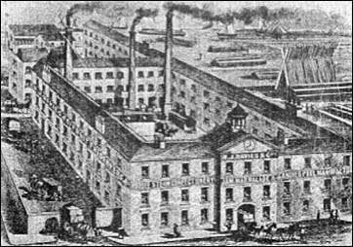
The Poor Law & The Workhouses
The Poor Law was the way that the poor were helped in 1815. The law said that each parish had to look after its own poor. If you were unable to work then you were given some money to help you survive. However, the cost of the Poor Law was increasing every year. By 1830 it cost about £7 million and criticism of the law was mounting.
What problems in society do you think occurred because of this?
In 1834 the Poor Law Amendment Act was passed by Parliament. This was designed to reduce the cost of looking after the poor as it stopped money going to poor people except in exceptional circumstances. Now if people wanted help they had to go into a workhouse to get it.
Which character represents the poor in A Christmas Carol?
Can he be considered idle and useless?
What is Dickens’ point of view?

Slide 26
Task: Scrooge’s attitude to the poor
Cold, economical language: the poor are numbers on a ledger to Scrooge.
As the poor don’t add wealth into society, they are of no use.
“decrease the surplus population”
Scrooge dehumanises the poor and separates them from the rich.
Using the above quotation, incidents in Stave One and your knowledge of the Victorian era, write a PEE chain that answers the following question: What is Scrooge’s attitude to the poor?

Slide 27
Plenary Activity: Atmosphere Context
Meanwhile the fog and darkness thickened so, that people ran about with flaring links, proffering their services to go before horses in carriages, and conduct them on their way. The ancient tower of a church, whose gruff old bell was always peeping slyly down at Scrooge out of a Gothic window in the wall, became invisible, and struck the hours and quarters in the clouds, with tremulous vibrations afterwards as if its teeth were chattering in its frozen head up there. The cold became intense. In the main street at the corner of the court, some labourers were repairing the gas-pipes, and had lighted a great fire in a brazier, round which a party of ragged men and boys were gathered: warming their hands and winking their eyes before the blaze in rapture.
How does Dickens create mood and atmosphere in the following extract?
Tips for success:
Look for 5-6 ideas
Keep highlighted evidence short
Analyse language closely (always look for layers of meaning)
Ask yourself: how does this add to/change the atmosphere?
Track through and find points across the entire extract

Slide 28
Starter Activity: Peer Assessment
Possible answers:
Scrooge’s evil attitude is linked to the weather: “fog and darkness thickened so” (pathetic fallacy)
The poor desperately hold on to their Christmas spirit: “ran about with flaring links” (symbolism)
God is watching, disapproving of Scrooge: “old bell was peeping slyly down at Scrooge” (personification)
The negative atmosphere grows: “The cold became intense.” (short sentence for effect)
The poor suffer yet support each other through their difficulties: “before the blaze in rapture.” (religious connotations)
Assessment Criteria:
Look for 5-6 ideas
Keep highlighted evidence short
Analyse language closely (always look for layers of meaning)
Ask yourself: how does this add to/change the atmosphere?
Track through and find points across the entire extract
Complete two stars and a wish on your partner’s work – set them a clear target!

Slide 29
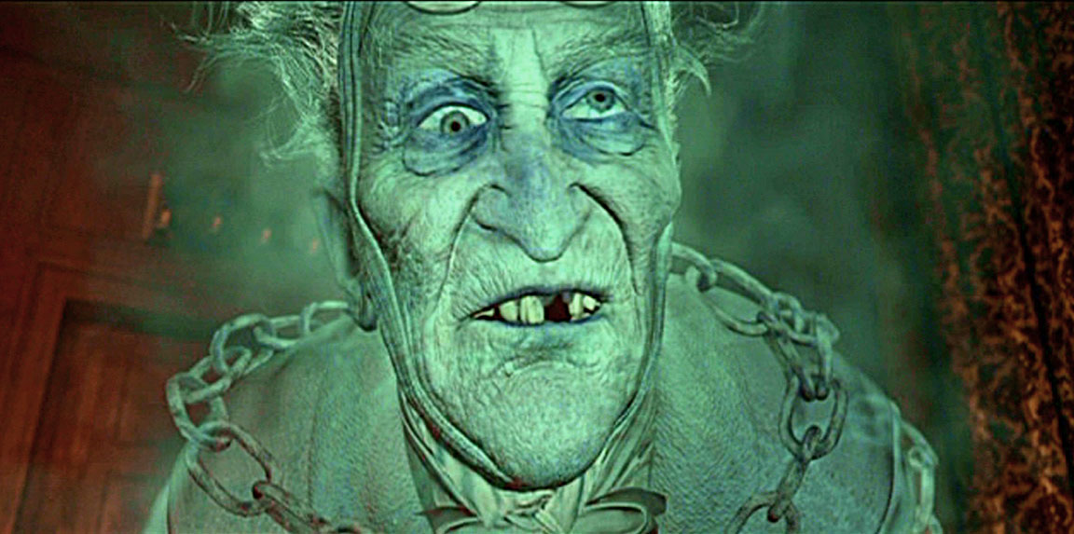
A Christmas Carol
Marley and his chains

Slide 30
Learning Objectives
By the end of the lesson…
You will explore Marley’s arrival and purpose in the novella
You will practise using PEE & analysing extracts

Slide 31
Task: PEE analysis
What does Marley attempt to teach Scrooge?
The chain was made “of cash-boxes, keys, padlocks, ledgers, deeds, and heavy purses wrought in steel.” (p. 8)
“I wear the chain I forged in life […] I made it link by link” (p. 10)
“Or would you know […] the weight and length of the strong coil you bear yourself?” (p. 10)
“In life my spirit never roved beyond the narrow limits of our money-changing hole” (p. 10)

Slide 32
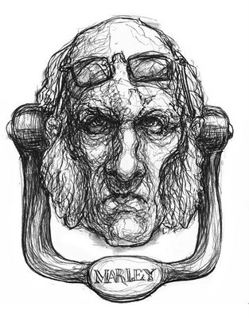
Plenary Task: Think, Pair, Share
Why would Dickens foreshadow the arrival of Marley by linking his face to a doorknocker?

Slide 33
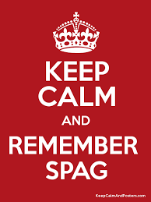
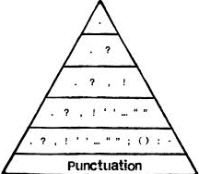
Starter Activity: SPaG Worksheet
Complete the SPaG sheet on your table.
Be ready to offer answers and mark your own work!

Slide 34
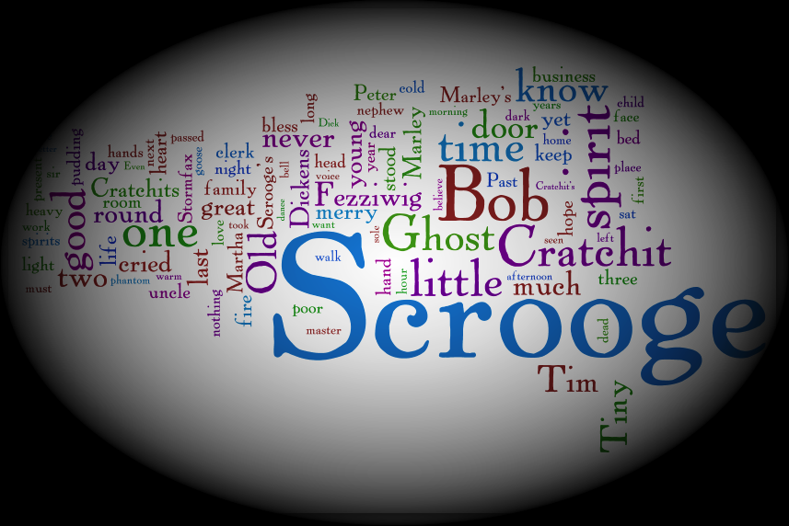
A Christmas Carol
Marley’s warning

Slide 35
Learning Objectives
By the end of the lesson…
You will understand Marley’s warning
You will consolidate your knowledge of Stave One

Slide 36
Mini-essay One: Scrooge’s Characterisation
You are going to write a short essay for homework on the following question:
How does Dickens present Scrooge’s character in Stave One?
Assessment Criteria:
Show you understand the character and his relationships
Use evidence to support your ideas
Analyse the language closely (layers of meaning)
Make references to the historical context
Essay Structure:
Introduction (short overview);
Three PEE paragraphs (in chronological order);
Conclusion (summarise your main ideas).
Essay Length:
1.5-2 pages in your exercise book

Slide 37
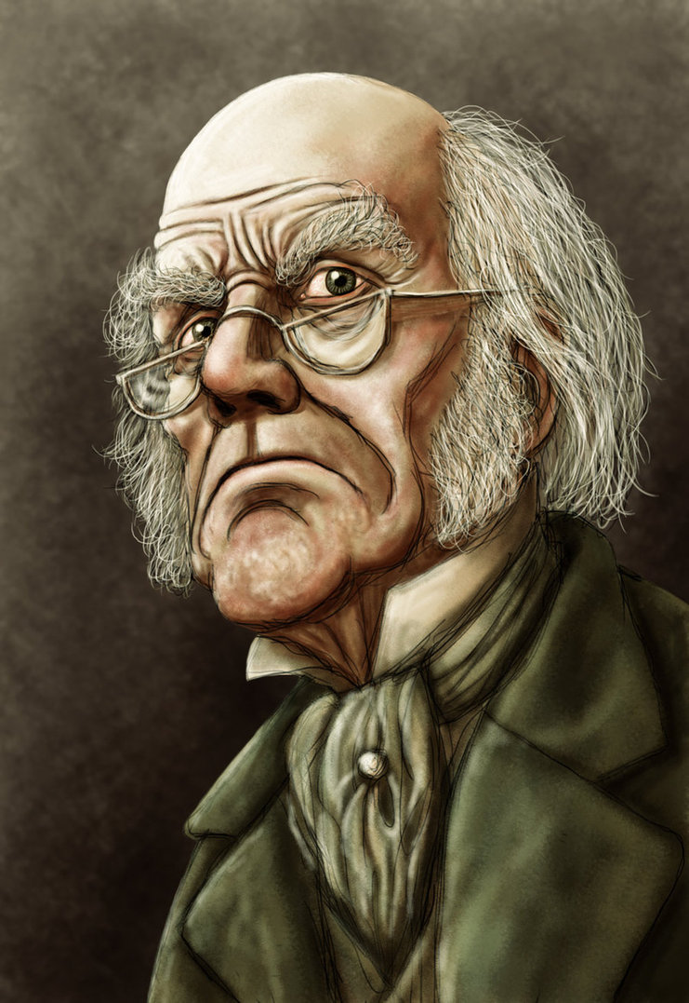
Plenary Activity: Quotation Hunt
You must spend the rest of the lesson selecting evidence from Stave One to include in your homework essay.
Be sure to:
Choose short quotations
Choose quotations that lead you to different ideas about Scrooge’s character

