Slide 1
Starter Activity: Stave Two Cloze Summary
Scrooge meets the Ghost of Christmas Past. It symbolises _________ as Scrooge must relive his past to reconnect with his former, _________ self. First, Scrooge watches himself as a lonely child in school. He cries for himself and the reader feels ___________ and begins to understand how he came to be so evil.
Scrooge takes the first step on the road to ___________ by regretting not giving money to a child who sung him a Christmas carol. He then watches his sister, __________, and we learn she dies – Scrooge feels guilty about his nephew, ___________.
Scrooge watches __________ throw a party for his workers. Scrooge begins to enjoy himself and learns that living a _______________ is harmful and that being disconnected from people doesn’t make life better.
Finally, Scrooge watches the break-up of his ___________ with Belle: he becomes distressed as he is forced to see how a “____________” has become his obsession (i.e. money). Scrooge sits alone and realises he hasn’t had a friend since __________ and the ghost disappears; Scrooge falls into a deep sleep.
Scrooge meets the Ghost of Christmas Past. It symbolises memory as Scrooge must relive his past to reconnect with his former, innocent self. First, Scrooge watches himself as a lonely child in school. He cries for himself and the reader feels sympathy and begins to understand how he came to be so evil.
Scrooge takes the first step on the road to salvation by regretting not giving money to a child who sung him a Christmas carol. He then watches his sister, Little Fan, and we learn she dies – Scrooge feels guilty about his nephew, Fred.
Scrooge watches Fezziwig throw a party for his workers. Scrooge begins to enjoy himself and learns that living a solitary life is harmful and that being disconnected from people doesn’t make life better.
Finally, Scrooge watches the break-up of his engagement with Belle: he becomes distressed as he is forced to see how a “golden idol” has become his obsession (i.e. money). Scrooge sits alone and realises he hasn’t had a friend since Marley and the ghost disappears; Scrooge falls into a deep sleep.

Slide 2
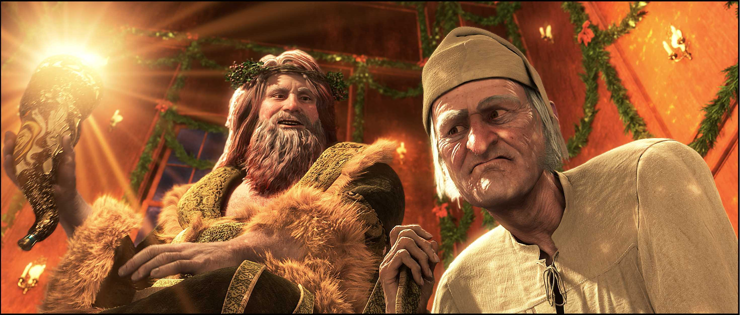
A Christmas Carol
The Ghost of Christmas Present

Slide 3
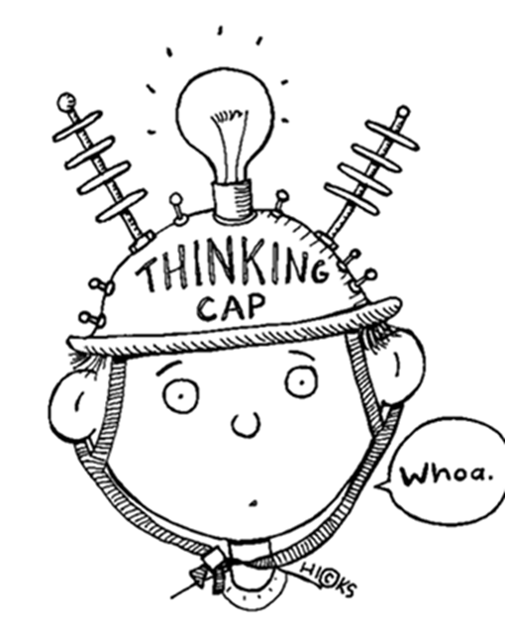
Learning Objectives
By the end of the lesson…
You will understand the importance of the Ghost of Christmas Present
You will be able to relate the historical context (a Victorian Christmas) to the novella

Slide 4
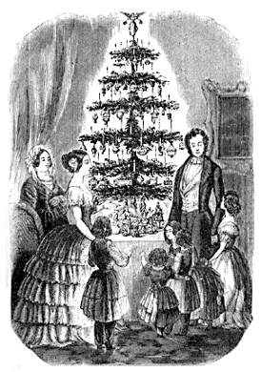
Historical Context: A Victorian Christmas
Before Victoria's reign started in 1837, nobody in Britain had heard of Santa Claus or Christmas Crackers. No Christmas cards were sent and most people did not have holidays from work. The wealth and technologies generated by the industrial revolution of the Victorian era changed the face of Christmas forever..
Sentimental do-gooders like Charles Dickens wrote books like "Christmas Carol", published in 1843, which actually encouraged rich Victorians to redistribute their wealth by giving money and gifts to the poor - Humbug! These radical middle class ideals eventually spread to the not-quite-so-poor as well.
How is this information important to understanding A Christmas Carol?

Slide 5
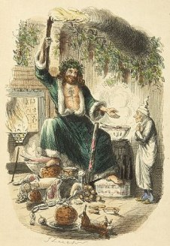
Historical Context: Santa Claus
Father Christmas or Santa Claus: The two are in fact two entirely separate stories. Father Christmas was originally part of an old English midwinter festival, normally dressed in green, a sign of the returning spring. The stories of St. Nicholas (Sinter Klaas in Holland) came via Dutch settlers to America in the 17th Century. From the 1870's Sinter Klass became known in Britain as Santa Claus and with him came his unique gift and toy distribution system - reindeer and sleigh.
How is this information important to understanding A Christmas Carol?

Slide 6
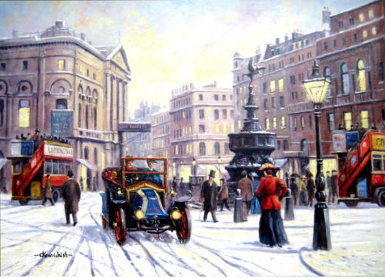
Plenary Activity: Sketch a Christmas card
In the back of your exercise book, sketch a Victorian Christmas scene.
Use some of the idealised imagery from the novella to inspire your Christmas card.

Slide 7
Starter Activity: Grading a Response
“Then up rose Mrs Cratchit dressed out but poorly in a twice-turned gown, but brave in ribbons, which are cheap and make a goodly show for sixpence”
What does this tell us about the Cratchit family?
Mrs Cratchit “rose up” implying she can’t be kept down by poverty. Although her gown is “twice-turned”, the use of “ribbons” demonstrate her festive spirit and show the reader she is “brave” and determined to make the most of her situation. Her character is strong, even though her finances are weak.
Mrs Cratchit is poor, but she tries to make an effort with the way she looks by wearing “ribbons”, which are festive. She wants to keep everyone’s spirits up and is “goodly” despite her poverty.
Which is the superior answer and why?

Slide 8
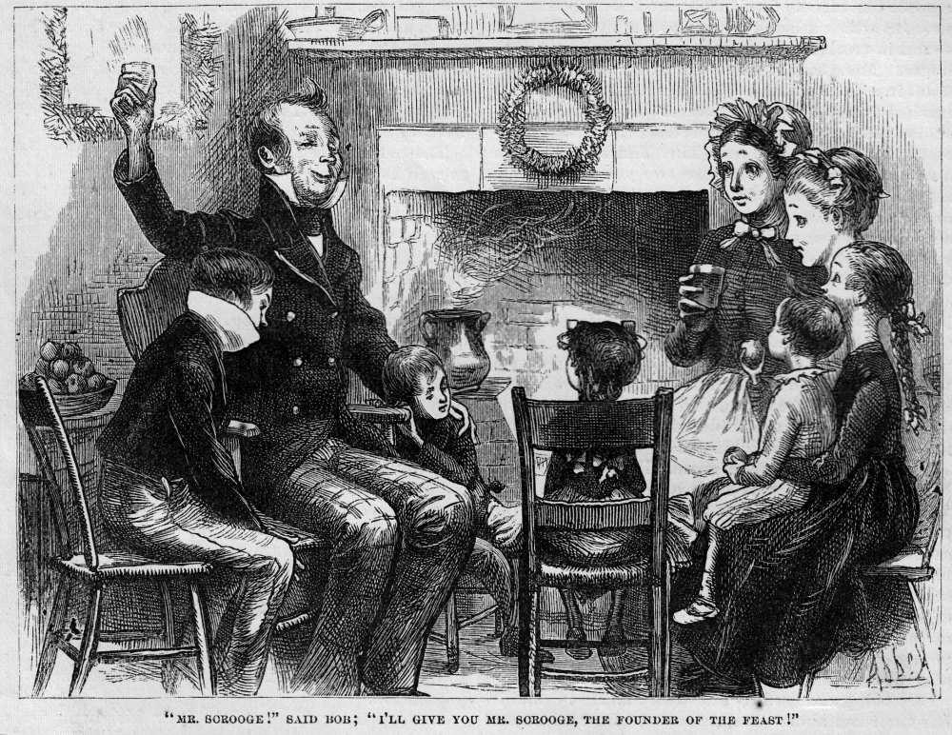
A Christmas Carol
The Cratchit Family Christmas

Slide 9
Learning Objectives
By the end of the lesson…
You will understand the importance of the Cratchit family
You will engage with the theme of poverty

Slide 10

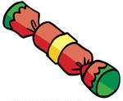
Task: Comprehension Questions
1. Why might Dickens include a scene in which the Cratchit family cook their Christmas meal?
2. Why does Mrs Cratchit invite her daughter to sit down “before the fire”?
3. Why might Dickens include the image of Bob carrying his son?
4. How are the references to church important?
5. Why might Bob say that his son is “good as gold”?
6. How do the Cratchit family feel about their meal?
7. How does Scrooge react to watching this scene?
8. Why might Dickens include Bob toasting Scrooge as the “founder of the feast”?
9. Overall, what is the atmosphere in this scene?

Slide 11
Plenary Activity: Peer Assessment
1. Dickens wants to show the middle classes that the poor co-operate and show love through mutual support.
2. The fire represents the Cratchits’ Christmas spirit, which is strong throughout Stave Three.
3. Bob carries the family financially, despite the heavy burden.
4. The Cratchit family are Christians who value love & family over money.
5. Bob values people according to their character, not their wealth.

Slide 12
Plenary Activity: Peer Assessment
6. Dickens exaggerates the Cratchit family’s reaction to emphasise how grateful they are. Ironically, the reader can clearly see the meal is not a “feast” and this causes sympathy.
7. Scrooge continues to grow as a person, realising that value should not be attached to money. He asks if Tiny Tim will be “spared”, showing he is now invested in other people.
8. This would shame Scrooge further and emphasise the humility of the Cratchits as they are grateful for everything they have.
9. The atmosphere is overflowing with positive Christmas spirit which starkly contrasts with the desperate poverty of the family.

Slide 13

Starter Activity: Context Questions
Look back over your previous context question (from Stave One):
What target was set for you to improve?
What is the assessment criteria for a context question?
Assessment Criteria:
Look for 5-6 ideas
Keep highlighted evidence short
Analyse language closely (always look for layers of meaning)
Ask yourself: how does this add to/change the atmosphere?
Track through and find points across the entire extract

Slide 14
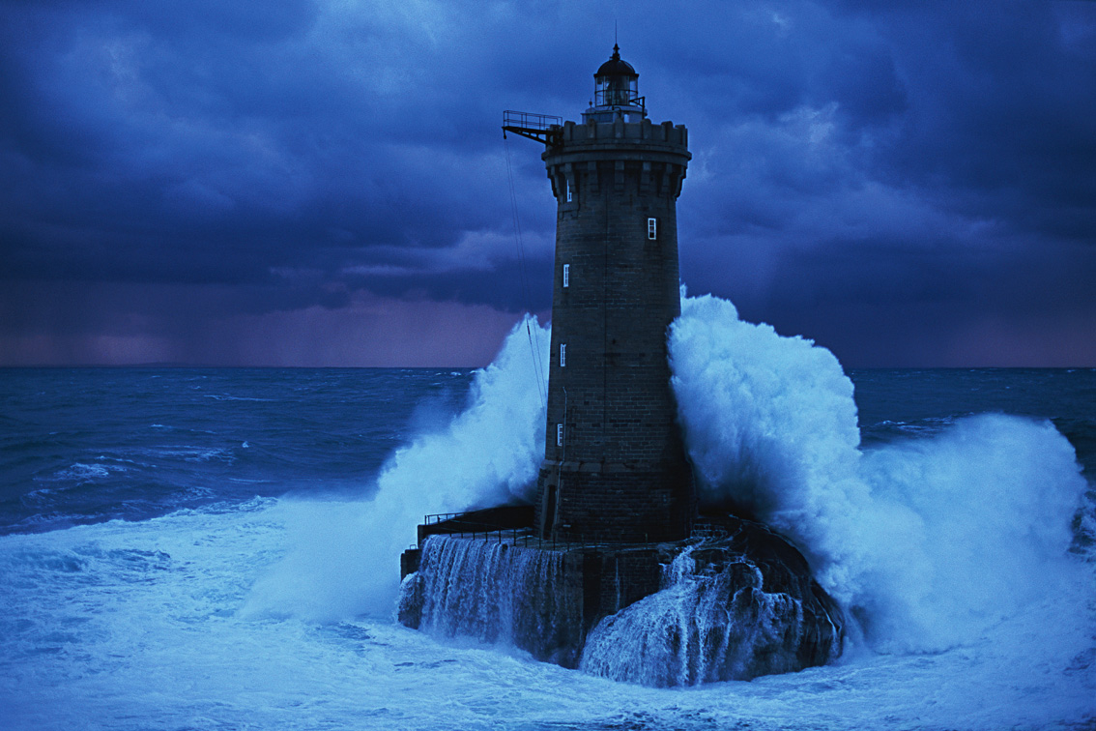
A Christmas Carol
The Lighthouse & Fred’s Christmas Party

Slide 15
Learning Objectives
By the end of the lesson…
You will closely analyse language and explore the writer’s craft
You will become better aware of the assessment criteria

Slide 16
Task: Atmosphere Context Question
You have twenty minutes to complete the question
(5 minutes to read/annotate and 15 minutes to write).
Aim to write 1.5-2 pages in your exercise book.
Exam conditions!
How does Dickens create mood and atmosphere in the following extract?
Tips for success:
Look for 5-6 ideas
Keep highlighted evidence short
Analyse language closely (always look for layers of meaning)
Ask yourself: how does this add to/change the atmosphere?
Track through and find points across the entire extract

Slide 17
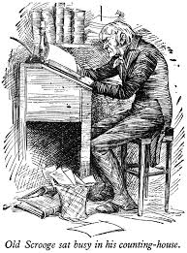
Plenary Activity: Peer Assessment
Switch books with your partner
Glue in the assessment worksheet
Write your name at the top of the sheet
Read their response and tick or cross the sheet as required
Complete two stars and a wish

Slide 18
Starter Activity: Textual Analysis
‘Forgive me if I am not justified in what I ask," said Scrooge, looking intently at the Spirit's robe, "but I see something strange, and not belonging to yourself, protruding from your skirts. Is it a foot or a claw?"
"It might be a claw, for the flesh there is upon it," was the Spirit's sorrowful reply. "Look here."
From the foldings of its robe, it brought two children; wretched, abject, frightful, hideous, miserable. They knelt down at its feet, and clung upon the outside of its garment.’
1. What could have Scrooge spotted?
2. What might their significance be?
3. What does the list of adjectives remind you of?

Slide 19
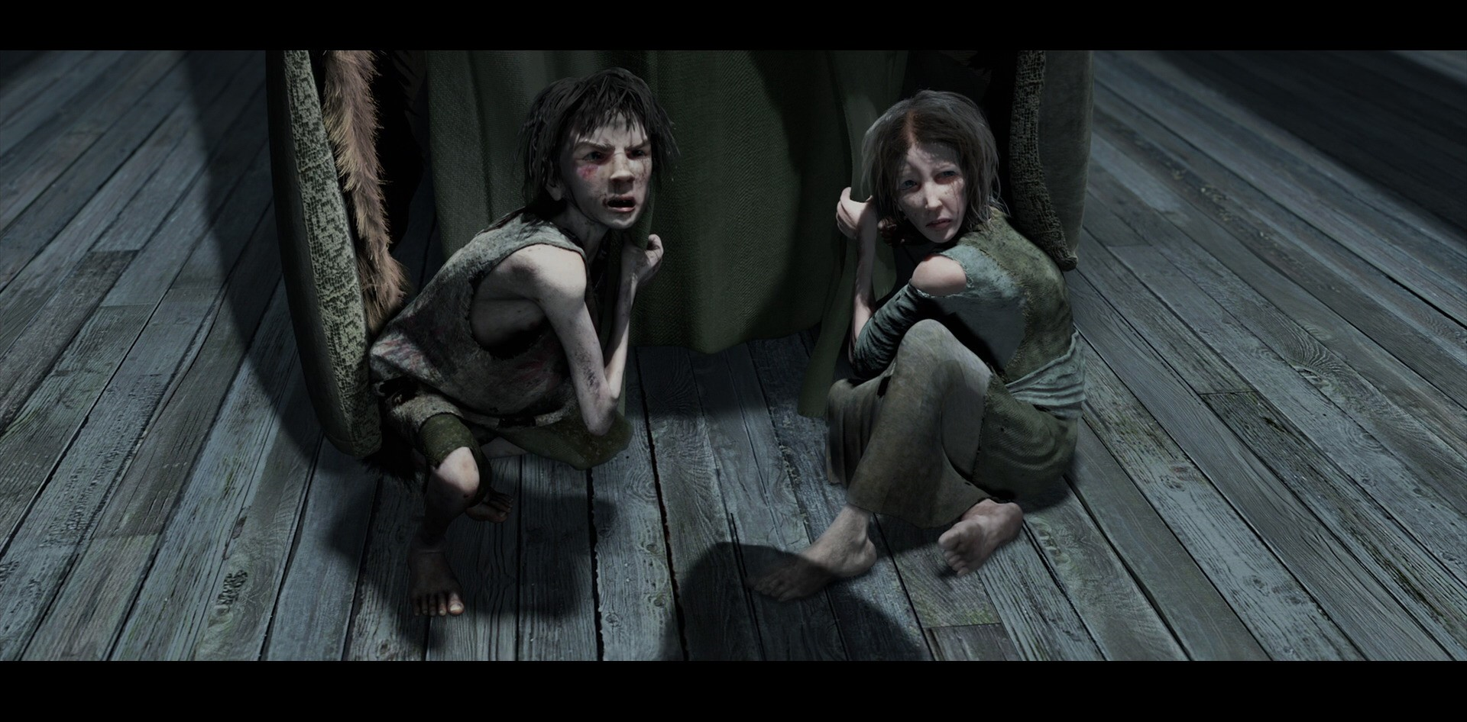
A Christmas Carol
Ignorance & Want

Slide 20
Learning Objectives
By the end of the lesson…
You will understand the significance of Ignorance & Want
You will gain a deeper understand of Dickens’ moral message

Slide 21
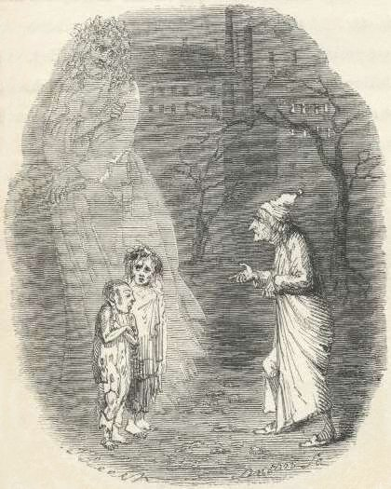
Ignorance and Want
The two children are allegories of two social problems: Ignorance and Want. They represent these problems in human form.
Notice: they have capital letters to show this.

Slide 22
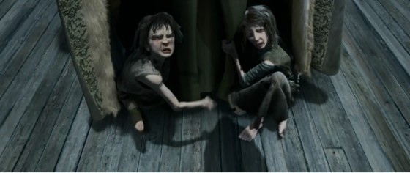
Ignorance: People like Scrooge, who ignore the problems of the poor, create enormous social problems. They create children like this.
Want: because the population has ‘boomed’ in Victorian times, many people ‘want for’ (go without) the basic necessities such as food and shelter. Combined with the ignorance of the rich, this creates massive social problems. It creates children like this.
These children will grow into adults who live a life of crime, causing bigger problems and creating a cycle.

Slide 23
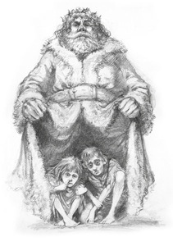
Task: Ignorance & Want Questions
Answers the questions on the worksheet about Ignorance & Want.
Note:
Ignorance & Want are vital to understanding Dickens’ social message.
You can you them as an example in most essays in the exam!

Slide 24
Mini-essay Two: The Christmas Spirit
You are going to write a short essay for homework on the following question:
How does Dickens present the theme of the Christmas spirit in Stave Three?
Assessment Criteria:
Show you understand the character and his relationships
Use evidence to support your ideas
Analyse the language closely (layers of meaning)
Make references to the historical context
Essay Structure:
Introduction (short overview);
Three PEE paragraphs (in chronological order);
Conclusion (summarise your main ideas).
Essay Length:
1.5-2 pages in your exercise book

Slide 25
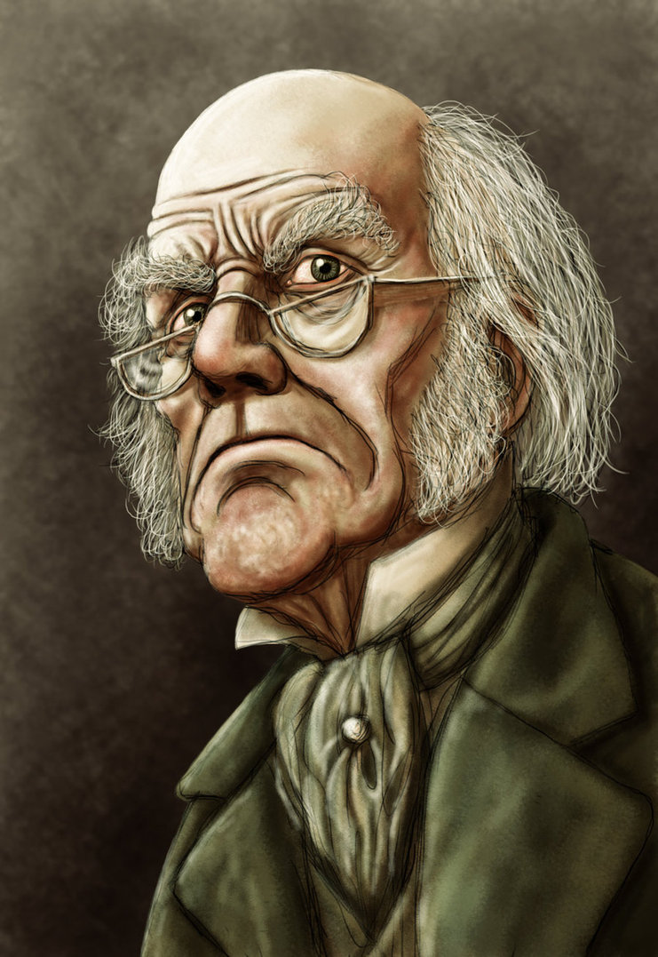
Plenary Activity: Quotation Hunt
You must spend the rest of the lesson selecting evidence from Stave Three to include in your homework essay.
Be sure to:
Choose short quotations
Choose quotations that lead you to different ideas about the Christmas spirit

