Slide 1
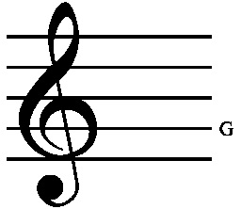
Starter Activity: what is a ‘stave’?
A stave is a set of five parallel lines on which music is written. The lines indicate the pitch of the music.
A stave is to break something by forcing it inwards or piercing it roughly.
Why did Dickens name the chapters of A Christmas Carol staves?
How do these definitions relate to the novella?

Slide 2
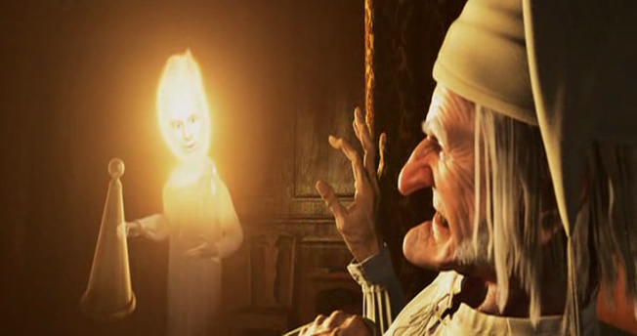
A Christmas Carol
The Ghost of Christmas Past

Slide 3
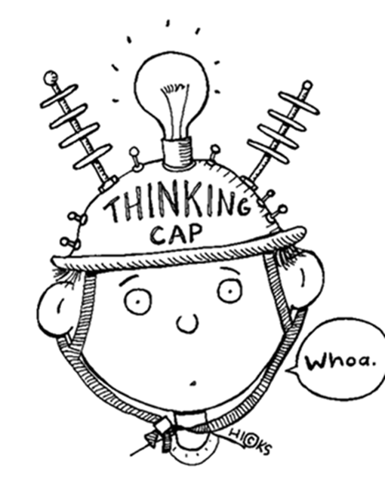
Learning Objectives
By the end of the lesson…
You will understand the structure of the novella
You will empathise with Scrooge

Slide 4
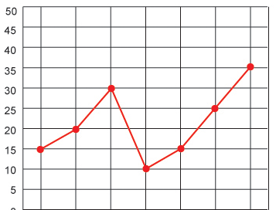
Task: Sympathy Graph
1. Take a full page of your exercise book to draw a graph (X-axis: Scrooge’s past, Y-axis: sympathy).
2. As we read through Stave Two track your level of sympathy for Scrooge.
3. Each key event (point on the graph) should be numbered.
4. On the next page, write a sentence to explain the moment and why you decided that level of sympathy.
Note that we be doing this next lesson: plan your graph size accordingly!

Slide 5
Plenary Activity: Sharing Results
Think, pair and share your results with your partner. How well do they relate? What are the major similarities and differences?
Author’s Craft: What is Dickens doing to the reader’s feelings for Scrooge in Stave Two? Why create Old Scrooge and change our opinion with Young Scrooge?
Should our results all be the same?

Slide 6

Starter Activity: Hot-Seating Scrooge
Write three questions for Old Scrooge (from Stave One) and three questions for Young Scrooge (from Stave Two) in the back of your exercise book.
Be ready to take the hot seat or ask a question!

Slide 7
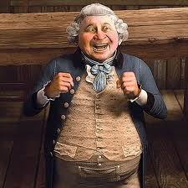
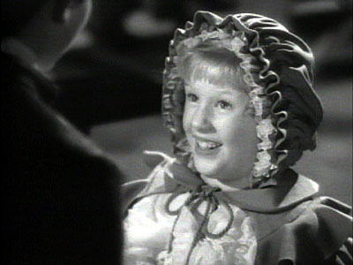
A Christmas Carol
Little Fan & Fezziwig

Slide 8
Learning Objectives
By the end of the lesson…
You will empathise with Scrooge
You will understand the character and function of Fezziwig

Slide 9
Task: Sympathy Graph
Continue with your graph from last lesson.
Remember to track key moments of sympathy and note why you made your choices on the opposite page.

Slide 10

Task: Fezziwig’s Party Questions
How do Mr and Mrs Fezziwig treat their workers at the end of the party?
Where do the prentices sleep? Why does Dickens add this detail?
How does Scrooge’s behaviour change throughout the party?
What is the ghost’s lesson for Scrooge to learn?
Where do the themes of the Christmas spirit and poverty appear in the party scene?
What do you think Scrooge would like to say to the clerks?

Slide 11
Plenary Task: Peer Assessment
Regardless of class, they “shake hands with every person individually”.
The prentices sleep “under a counter” to show their lives are ruled by money.
Scrooge begins to remember and reconnect with his former happy self.
Scrooge learns that a little money can make a big difference to poor people.
The poor, despite their circumstances, are full of the Christmas spirit. Wealth and happiness are not connected.
Scrooge is self-reflecting and would like to make amends with his clerk, Bob.
Mark your partner’s work. Check the content, but keep an eye out for SPaG errors too!

Slide 12
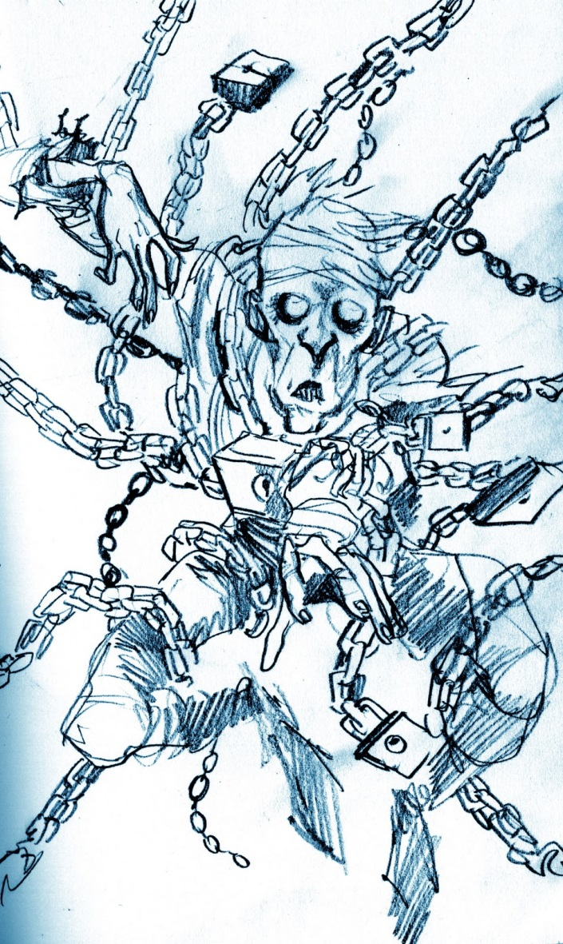
Starter Activity: The Useful Haunting
Read the persuasive speech, ‘The Useful Haunting’. It tries to argue that the most influential character to Scrooge in the novella (so far) is Marley.
Highlight and annotate the following persuasive devices in the speech:
Emotive language, evidence, direct address, rhetorical question, rule of three, repetition, short sentences and counter argument.
How effective is the speech in your opinion and why?

Slide 13
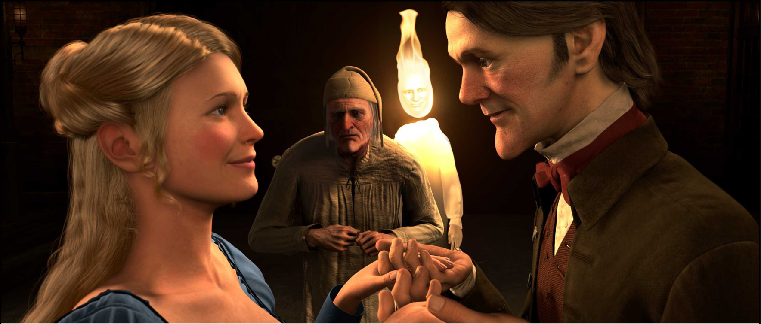
A Christmas Carol
Belle & The Engagement

Slide 14
Learning Objectives
By the end of the lesson…
You will be able to create a persuasive argument for a character
You will consolidate your knowledge of Stave Two

Slide 15

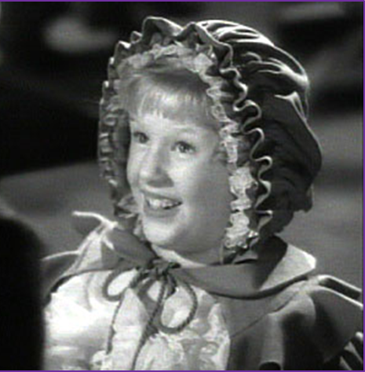

Task: Persuasive Speech
With your partner, write a persuasive speech, in the back of your book, that argues for Little Fan, Belle or Fezziwig as the most influential character to Scrooge in Stave Two. Use The Useful Haunting as a guide. Be ready to deliver your speech at the end of the lesson!
Include some of the following persuasive devices:
Emotive language, evidence, direct address, rhetorical question, rule of three, repetition, short sentences and counter argument.
Use the correct layout and pay attention to SPaG!

Slide 16
Plenary Activity: Debate!
I want to hear at least one argument for each of the characters. Listen closely to the pair speaking, as I may ask you to explain the persuasive devices they used or to counter argue their point of view!
Persuasive devices:
Emotive language, evidence, direct address, rhetorical question, rule of three, repetition, short sentences and counter argument.
Class Vote:
Which pair had the most persuasive argument?
Who is the most influential character in Stave Two?

