Slide 1
Starter Activity: Stave Three Cloze Summary
Scrooge meets the Ghost of Christmas Present. He symbolises __________________________. He sits on a throne of food and wear a __________ with no sword (which symbolises peace). The ghost shows Scrooge the Christmas of other people: he waves his torch to spread the Christmas Spirit, focusing on poor people as they “______________”.
They visit the Cratchit family, who offer the reader an idealised version of the Christmas for the poor. They wear “____________” to celebrate the day and work as a team to create their meagre Christmas dinner. They _____________ Scrooge, despite the fact that he underpays Bob and treats him poorly. Scrooge becomes upset for Tiny Tim when the ghost reveals he will die.
At Fred’s Christmas party, everyone enjoys themselves. The Cratchit family represents the poor and Fred’s party represents the _________ ___________. They make fun of Scrooge and his behaviour. Fred says his wealth is of no use as he “_____________________________”.
The ghost shows Scrooge __________________________: they are personified problems of society. Scrooge is horrified and asked if they can be helped, but the ghost uses his own words to shame him: “_________________________________________________________” The ghost dies.
Scrooge meets the Ghost of Christmas Present. He symbolises generosity and goodwill. He sits on a throne of food and wear a scabbard with no sword (which symbolises peace). The ghost shows Scrooge the Christmas of other people: he waves his torch to spread the Christmas Spirit, focusing on poor people as they “need most”.
They visit the Cratchit family, who offer the reader an idealised version of the Christmas for the poor. They wear “ribbons” to celebrate the day and work as a team to create their meagre Christmas dinner. They toast Scrooge, despite the fact that he underpays Bob and treats him poorly. Scrooge becomes upset for Tiny Tim when the ghost reveals he will die.
At Fred’s Christmas party, everyone enjoys themselves. The Cratchit family represents the poor and Fred’s party represents the middle classes. They make fun of Scrooge and his behaviour. Fred says his wealth is of no use as he “doesn’t’ do any good with it”.
The ghost shows Scrooge Ignorance and Want: they are personified problems of society. Scrooge is horrified and asked if they can be helped, but the ghost uses his own words to shame him: “Are there no prisons? Are there no workhouses?” The ghost dies.

Slide 2
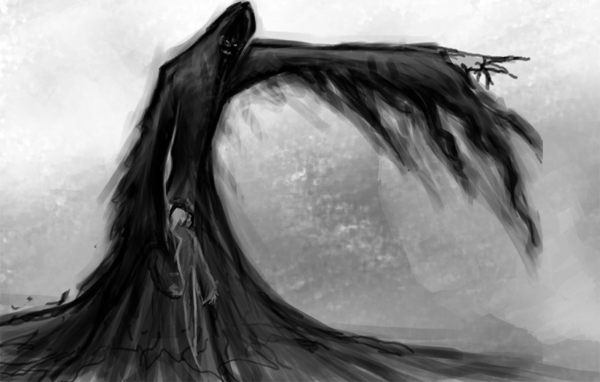
A Christmas Carol
The Ghost of Christmas Yet To Come

Slide 3
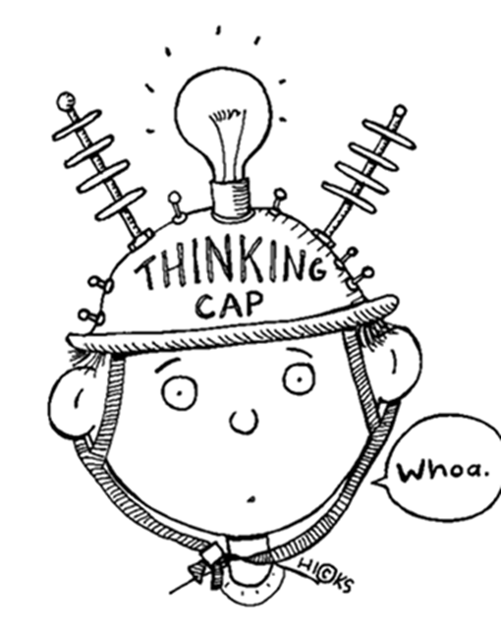
Learning Objectives
By the end of the lesson…
You will consolidate your knowledge of Ignorance & Want
You will explore the character of the Ghost of Christmas Yet To Come

Slide 4
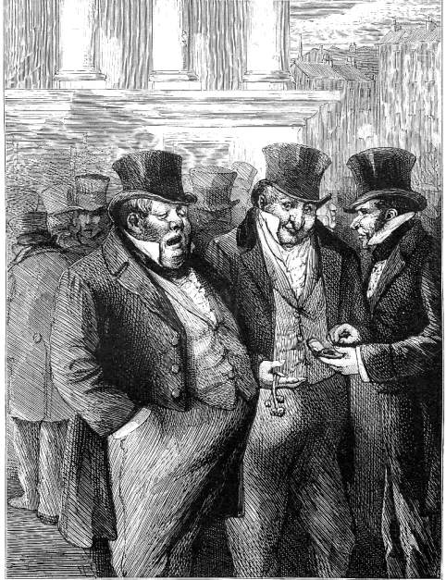
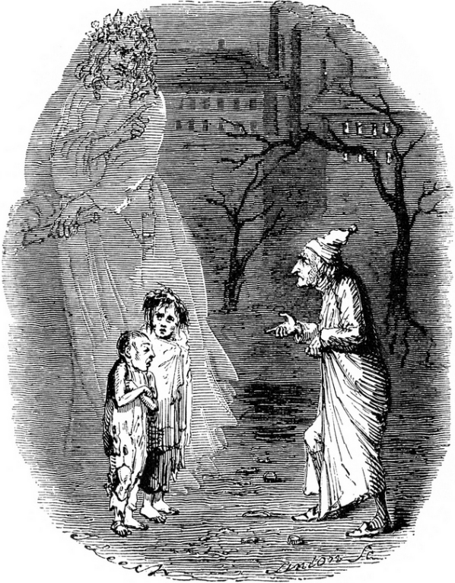
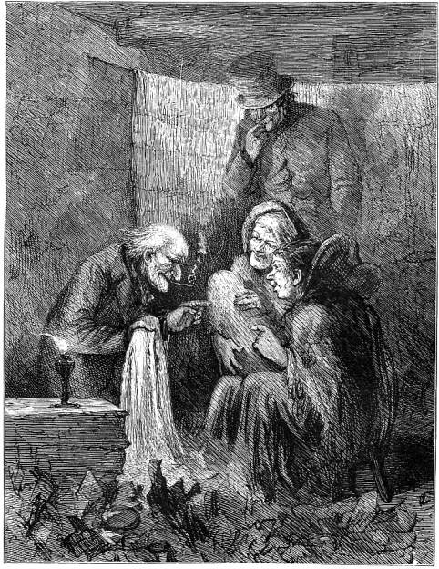
Task: Ignorance & Want
In Stave Three, Scrooge meets Ignorance and Want.
In Stave Four, Scrooge meets them again in human form.
Who do you think the characters are and why do they represent Ignorance and want?
Why might Dickens have chosen to structure the novella like this?

Slide 5
Plenary Activity: Context Question
They left the busy scene, and went into an obscure part of the town, where Scrooge had never penetrated before, although he recognised its situation, and its bad repute. The ways were foul and narrow; the shops and houses wretched; the people half-naked, drunken, slipshod, ugly. Alleys and archways, like so many cesspools, disgorged their offenses of smell, and dirt, and life, upon the straggling streets; and the whole quarter reeked with crime, with filth, and misery.
Far in this den of infamous resort, there was a low-browed, beetling shop, below a pent-house roof, where iron, old rags, bottles, bones, and greasy offal, were bought. Upon the floor within, were piled up heaps of rusty keys, nails, chains, hinges, files, scales, weights, and refuse iron of all kinds. Secrets that few would like to scrutinise were bred and hidden in mountains of unseemly rags, masses of corrupted fat, and sepulchres of bones. Sitting in among the wares he dealt in, by a charcoal stove, made of old bricks, was a grey-haired rascal, nearly seventy years of age; who had screened himself from the cold air without, by a frowsy curtaining of miscellaneous tatters, hung upon a line; and smoked his pipe in all the luxury of calm retirement.
How does Dickens create mood and atmosphere in the following extract?
Tips for success:
Look for 5-6 ideas
Keep highlighted evidence short
Analyse language closely (always look for layers of meaning)
Ask yourself: how does this add to/change the atmosphere?
Track through and find points across the entire extract

Slide 6
Starter Activity: Peer Assessment
Possible answers:
A “den of infamous resort” reinforces the desperation and animal nature of the poor
The “rusty keys, nails, chains, hinges, files, scales, weights and refuse iron” might remind the reader of Marley’s chains
The repeated references to “bones” suggests a graveyard (death)
The man is described as a “grey-haired rascal”. This description would suit Scrooge in Stave 1: Scrooge is looking into a mirror of the Counting House
The verb “slunk” implies wrong-doing as it is sly – this links to the “den” of the first paragraph
The “laugh” of the three people is full of desperation – the opposite of the Ghost of Christmas Present
Assessment Criteria:
Look for 5-6 ideas
Keep highlighted evidence short
Analyse language closely (always look for layers of meaning)
Ask yourself: how does this add to/change the atmosphere?
Track through and find points across the entire extract
Complete two stars and a wish on your partner’s work – set them a clear target!

Slide 7
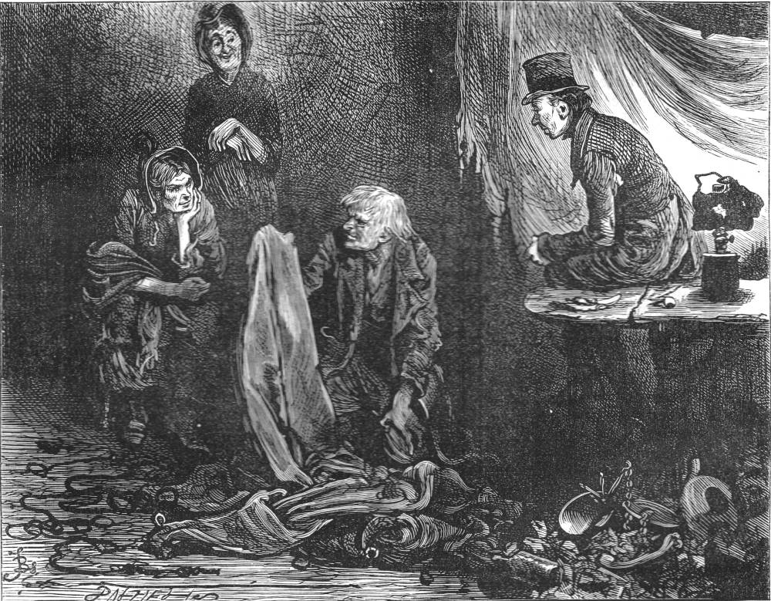
A Christmas Carol
Scrooge’s Debtors

Slide 8
Learning Objectives
By the end of the lesson…
You will deepen your knowledge of atmosphere context questions
You will reflect on Scrooge’s transformation

Slide 9
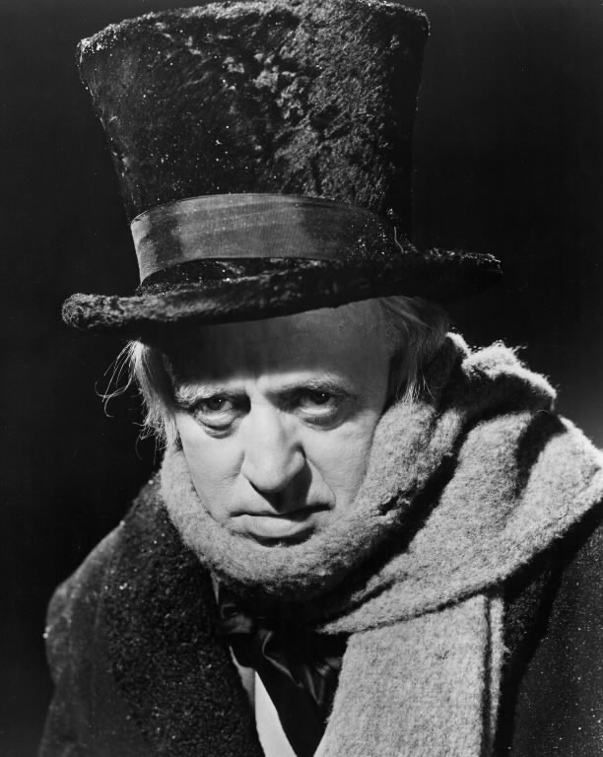
Task: Scrooge’s Transformation
“Every person has a right to take care of themselves. He always did.”
Scrooge undergoes a transformation throughout the novella: he redeems himself through the intervention of the ghosts.
Create a flowchart of the major quotations that show Scrooge’s change. Start with Stave One and move through to Stave Four (work chronologically).

Slide 10

Plenary Activity: Key Quotations
Choose a quotation that you consider to be important and write it on the post-it note with your name.
Stick it on the whiteboard and be prepared to explain your reasons if you are chosen.
“Decrease the surplus population.”

Slide 11
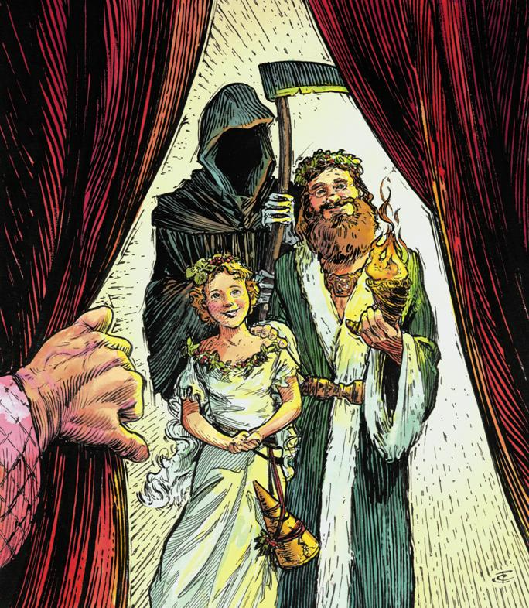
Starter Activity: The Ghosts
In your opinion, which ghost has had the biggest influence on Scrooge?
Make some notes in the back of your exercise book that explain your choice and be ready to feedback.

Slide 12
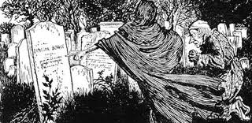
A Christmas Carol
Scrooge faces the truth

Slide 13
Learning Objectives
By the end of the lesson…
You will consolidate your knowledge of Stave Four
You will explore the Christmas Ghosts

Slide 14
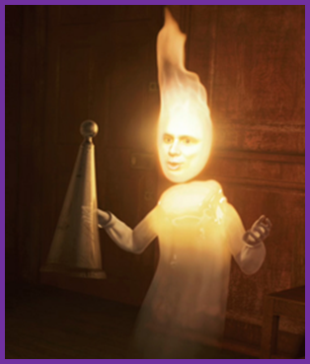
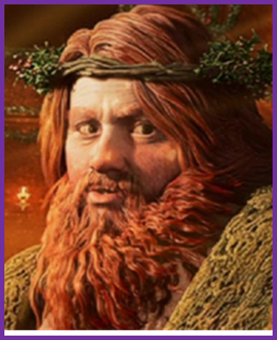
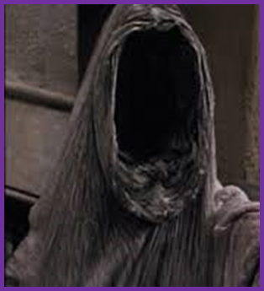
Task: Persuasive Speech
With your partner, write a persuasive speech, in the back of your book, that argues for the ghost that influences Scrooge the most. Use The Useful Haunting as a guide. Be ready to deliver your speech at the end of the lesson!
Include some of the following persuasive devices:
Emotive language, evidence, direct address, rhetorical question, rule of three, repetition, short sentences and counter argument.
Use the correct layout and pay attention to SPaG!

Slide 15
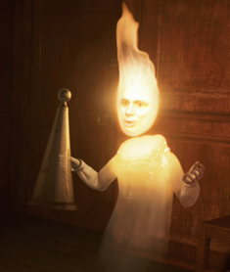
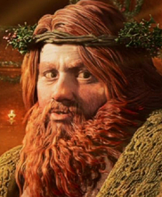
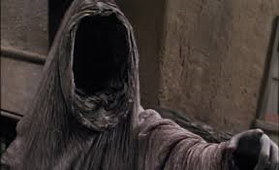
Plenary Activity: Debate!
I want to hear at least one argument for each of the ghosts. Listen closely to the pair speaking, as I may ask you to explain the persuasive devices they used or to counter argue their point of view!
Persuasive devices:
Emotive language, evidence, direct address, rhetorical question, rule of three, repetition, short sentences and counter argument.
Class Vote:
Which pair had the most persuasive argument?
Who is the most influential ghost in the novella?

Slide 16
Starter Activity: Stave Four Cloze Summary
Scrooge meets the Ghost of Christmas Yet to Come: he looks like the _____ ____________ (symbolising death). The ghost doesn’t speak; Scrooge does all the talking. This shows Scrooge’s _______________ as he has learnt lessons from the other ghosts.
The ghost shows us Scrooge’s business acquaintances (representing Ignorance in society). They are uninterested in what has happened to Scrooge and are only interested in a ______________. Like Marley, Scrooge’s funeral is “____________”.
The ghost then takes Scrooge to a ________ _________ where people have plundered his house and body and are selling his possessions (representing Want in society). _______ _________, Scrooge’s employee, says that the theft is a “______________” on him.
Next we meet some debtors of Scrooge who are relieved he has died. Scrooge also learns that _______ ________ has died. He is forced to witness the pain and suffering of ________, who tries to remain strong for his family’s sake.
Finally, the ghost shows Scrooge his grave. Scrooge repents and admits he is a changed man by declaring “I’m not the man I was” and “________________________________”.
Scrooge meets the Ghost of Christmas Yet to Come: he looks like the Grim Reaper (symbolising death). The ghost doesn’t speak; Scrooge does all the talking. This shows Scrooge’s transformation as he has learnt lessons from the other ghosts.
The ghost shows us Scrooge’s business acquaintances (representing Ignorance in society). They are uninterested in what has happened to Scrooge and are only interested in a free meal. Like Marley, Scrooge’s funeral is “cheap”.
The ghost then takes Scrooge to a pawn shop where people have plundered his house and body and are selling his possessions (representing Want in society). Mrs Dilber, Scrooge’s employee, says that the theft is a “judgement” on him.
Next we meet some debtors of Scrooge who are relieved he has died. Scrooge also learns that Tiny Tim has died. He is forced to witness the pain and suffering of Bob, who tries to remain strong for his family’s sake.
Finally, the ghost shows Scrooge his grave. Scrooge repents and admits he is a changed man by declaring “I’m not the man I was” and “I will honour Christmas in my heart”.

Slide 17
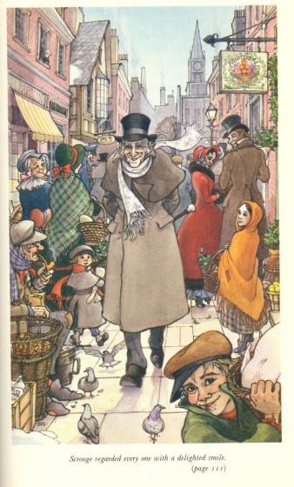

A Christmas Carol
Scrooge’s Redemption

Slide 18
Learning Objectives
By the end of the lesson…
You will begin to consider the transformation of Scrooge
You will evaluate the structure of the novella

Slide 19
Exploring the Similes: Scrooge’s change
“solitary as an oyster”
“hard and sharp as flint”
“merry as a schoolboy”
“light as a feather”
How do these similes contrast each other and demonstrate the nature of Scrooge’s change?

Slide 20
Task: Stave Structure Flowchart
Stave One | Stave Five
Scrooge is miserable to others | Scrooge is positive to others
Scrooge complains to Fred | Scrooge visits Fred for dinner
Scrooge refuses the charity men | Scrooge gives to charity
Scrooge goes home, alone | Scrooge goes to church
Scrooge complains about wages | Scrooge raises Bob’s wages
Scrooge’s fire is nearly dead | Scrooge orders the fires lit
What events in Stave Five parallel events in Stave One?
2. Why might Dickens have chosen this structure?

Slide 21
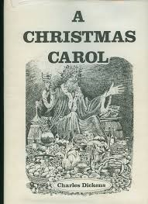
Plenary Activity: Essay Question
How does Dickens teach us that emotional support is more important than money?
Although called ‘A Christmas Carol’, the story isn’t finally about Christmas; it’s about our responsibility to others all year round. Discuss.
Some people have described ‘A Christmas Carol’ as a fairy-tale. For others it is a realistic portrayal of the sufferings of the Victorian poor. Which ‘reading’ of the book do you most agree with?
How far can ‘A Christmas Carol’ be regarded as a blueprint for the perfect Christmas?
Choose one of the essay questions and write a plan to answer it in the back of your exercise book.

Slide 22
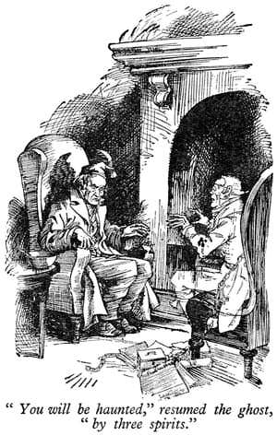

Starter Activity: Notes for Revision
Complete the top ten quotation worksheet by filling in the gaps.

Slide 23
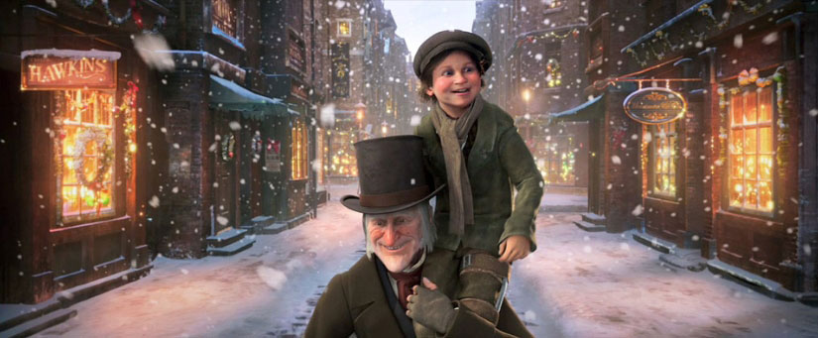
A Christmas Carol
The End!

Slide 24
Learning Objectives
By the end of the lesson…
You will consolidate your knowledge of Stave Five
You will explore Scrooge’s transformation

Slide 25
Mini-essay Three: Scrooge’s Redemption
You are going to write a short essay for homework on the following question:
How does Dickens present the Scrooge’s redemption in Stave Five?
Assessment Criteria:
Show you understand the character and his relationships
Use evidence to support your ideas
Analyse the language closely (layers of meaning)
Make references to the historical context
Essay Structure:
Introduction (short overview);
Three PEE paragraphs (in chronological order);
Conclusion (summarise your main ideas).
Essay Length:
1.5-2 pages in your exercise book

Slide 26
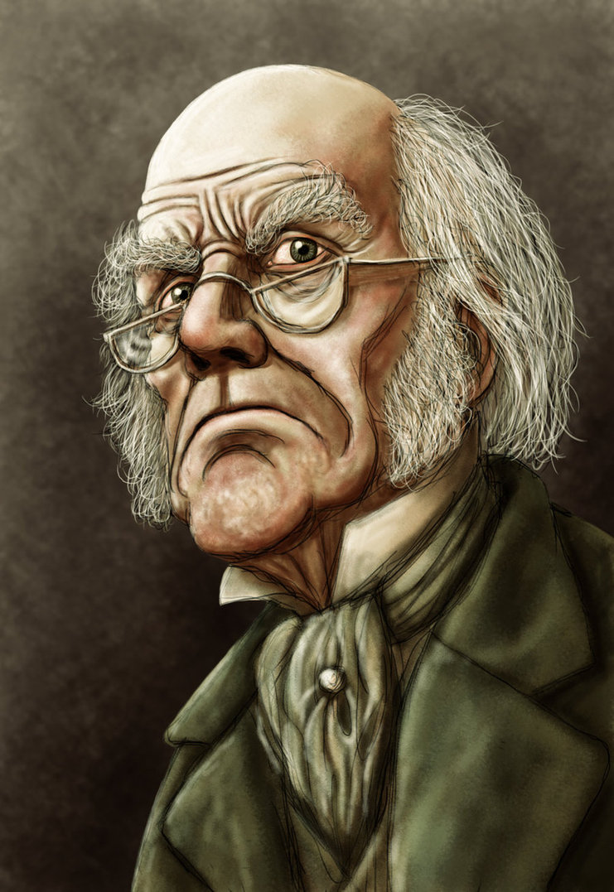
Plenary Activity: Quotation Hunt
You must spend the rest of the lesson selecting evidence from Stave Five to include in your homework essay.
Be sure to:
Choose short quotations
Choose quotations that lead you to different ideas about the Christmas spirit

