Slide 1
Aim: To know what the Buddhist 8 fold path is
Last week we looked at the 4 noble truths of Buddhism.
They were:
      Dukkha
        Samudāya
          Nirodha
            Magga

Slide 2
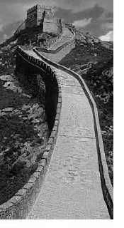
Aim: To know what the Buddhist 8 fold path is
Right view
Right intention
Right Speech
Right action
Right livelihood
Right effort
Right mindfulness
Right concentration

Slide 3
Aim: To know what the Buddhist 8 fold path is
Right View
To see things as they really are to follow the 4 noble truths.
Right Intention
To only do things that we know are good.

Slide 4
Aim: To know what the Buddhist 8 fold path is
Right Speech
To make sure that you do not tell lies, or say nasty things about other people.
To not say words that would hurt other people.
Right Action
To not harm our own bodies, or the bodies of other people.
To be kind and compassionate to other people, as well as their belongings.
Right Livlihood
To make sure that we earn money through good means.

Slide 5
Aim: To know what the Buddhist 8 fold path is
Right Effort
To understand that nothing can be achieved unless we put in lots of effort.
To use our mind’s energy and remain focussed.
Right Mindliness
To not let things get in the way of what we think, and to not be swayed by other people’s opinions or thoughts.
Right Concentration
To direct all the thoughts of our mind on to one thing (this is done through meditation).

Slide 6
The 8 Fold Path Information
Right view
Right intention
Right Speech
Right action
Right livelihood
Right effort
Right mindfulness
Right concentration

Slide 7
Aim: To know what the Buddhist 8 fold path is.
You need to write down one thing that a Buddhist could do to achieve each part of the 8 fold path.
Task:
Right view
Right intention
Right speech
Right action
Right livelihood
Right effort
Right mindfulness
Right concentration
Right View
To achieve the right view, it is important to follow the 4 noble truths. You can do this by having a poster explaining what each of the 4 noble truths are to remind you.
Right intention
To achieve the right intention…

