Slide 1
Budget at Home
Money Problems

Slide 2
Learning Objective
To calculate money problems at home.
Success Criteria
Solve problems involving:
decimal quantities of money

Slide 3
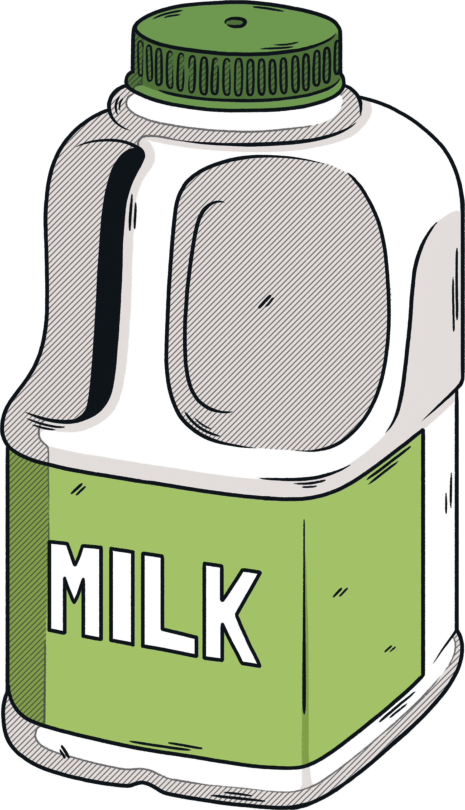
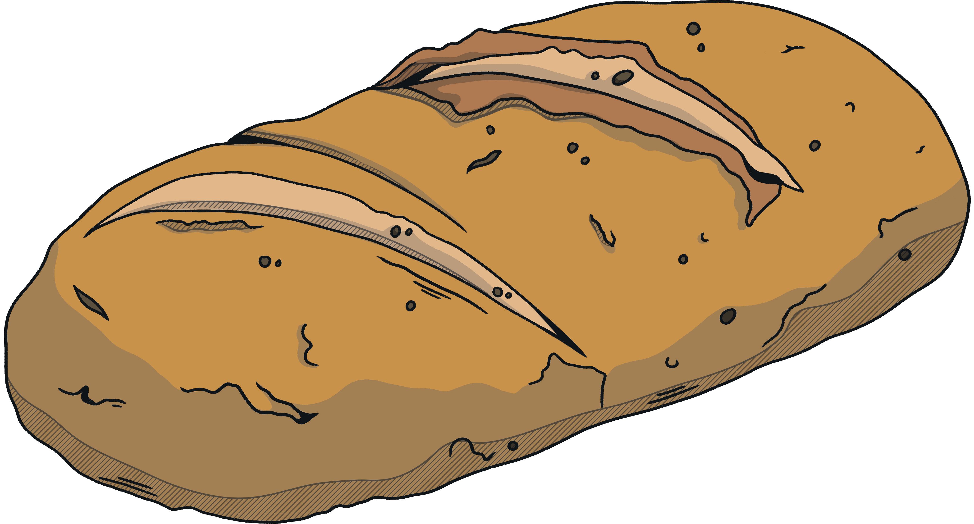
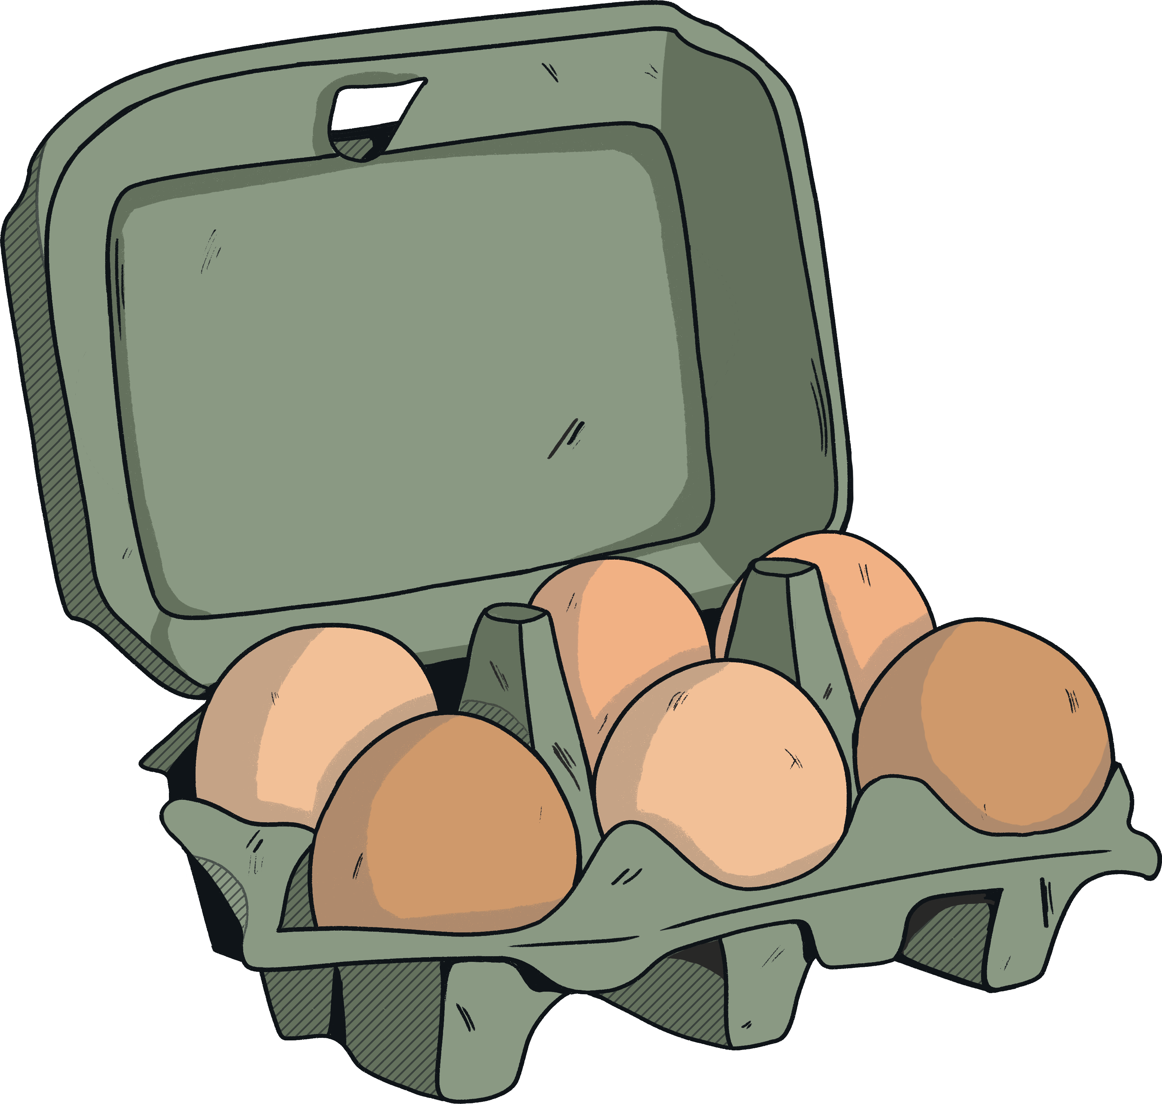
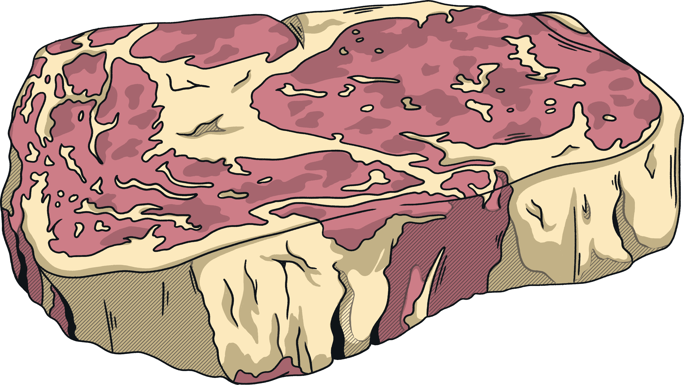
Groceries
You buy the following items:
£0.89
£1.73
£1.17
£4.16
How much change would you get from:
  £20
  £10
How much more money would you need if you had £5?

Slide 4
Groceries Answers
You buy the following items:
£0.89
£1.73
£1.17
£4.16
Total shopping = 4.16 + 0.89 + 1.17 + 1.73 = £7.95
How much change would you get from:
  £20 20 – 7.95 = £12.05
  £10 10 – 7.95 = £2.05
How much more money would you need if you had £5?
7.95 – 5 = £2.95

Slide 5

Homeware
A new mug costs:
£0.48
Show how many mugs you could buy and how much change you would get if you used these notes:
a. £20 b. £10 c. £5

Slide 6
Homeware Answers
A new mug costs:
£0.48
Show how many mugs you could buy and how much change you would get if you used these notes:
a. £20 b. £10 c. £5
20 ÷ 0.48 = 41.67
= 41 mugs
check: 0.48 × 41
= £19.68
change: 20 – 19.68
= £0.32
10 ÷ 0.48 = 20.83 = 20 mugs
check: 0.48 × 20
= £9.60
change: 10 – 9.60 = £0.40
5 ÷ 0.48 = 10.42 = 10 mugs
check: 0.48 × 10 = £4.80
change: 5 – 4.80 = £0.20

Slide 7

Decorating
: Invoice
Item | Cost per item | Quantity | Total Cost
Tin of paint | £ 12.86 | 3 | £________
Skirting board | £ 7.04 | 4 | £ 28.16
Interior door | £ 24.99 | ________ | £ 74.97
Plug socket | £_______ | 3 | £ 19.44
Total |  |  | £_________
Complete the invoice.
Dave charges £10.45 an hour for labour.
This job took him 13 hours.
What is the new total cost for the job, including labour and material costs?

Slide 8
Decorating Answers
: Invoice
Item | Cost per item | Quantity | Total Cost
Tin of paint | £ 12.86 | 3 | £ 38.58
Skirting board | £ 7.04 | 4 | £ 28.16
Interior door | £ 24.99 | 3 | £ 74.97
Plug socket | £ 6.48 | 3 | £ 19.44
Total |  |  | £ 161.15
Complete the invoice.
Dave charges £10.45 an hour for labour.
This job took him 13 hours.
What is the new total cost for the job, including labour and material costs?
Labour cost = 13 × 10.45 = £135.85
New job total = 135.85 + 161.15 = £297.00

Slide 9
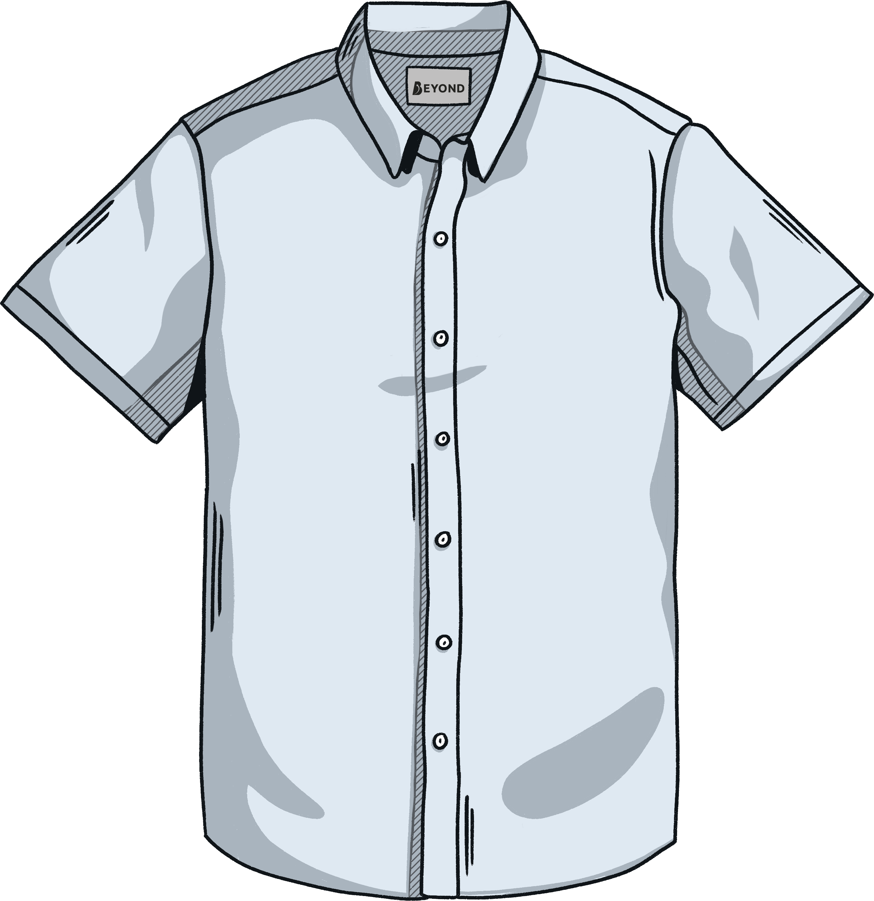
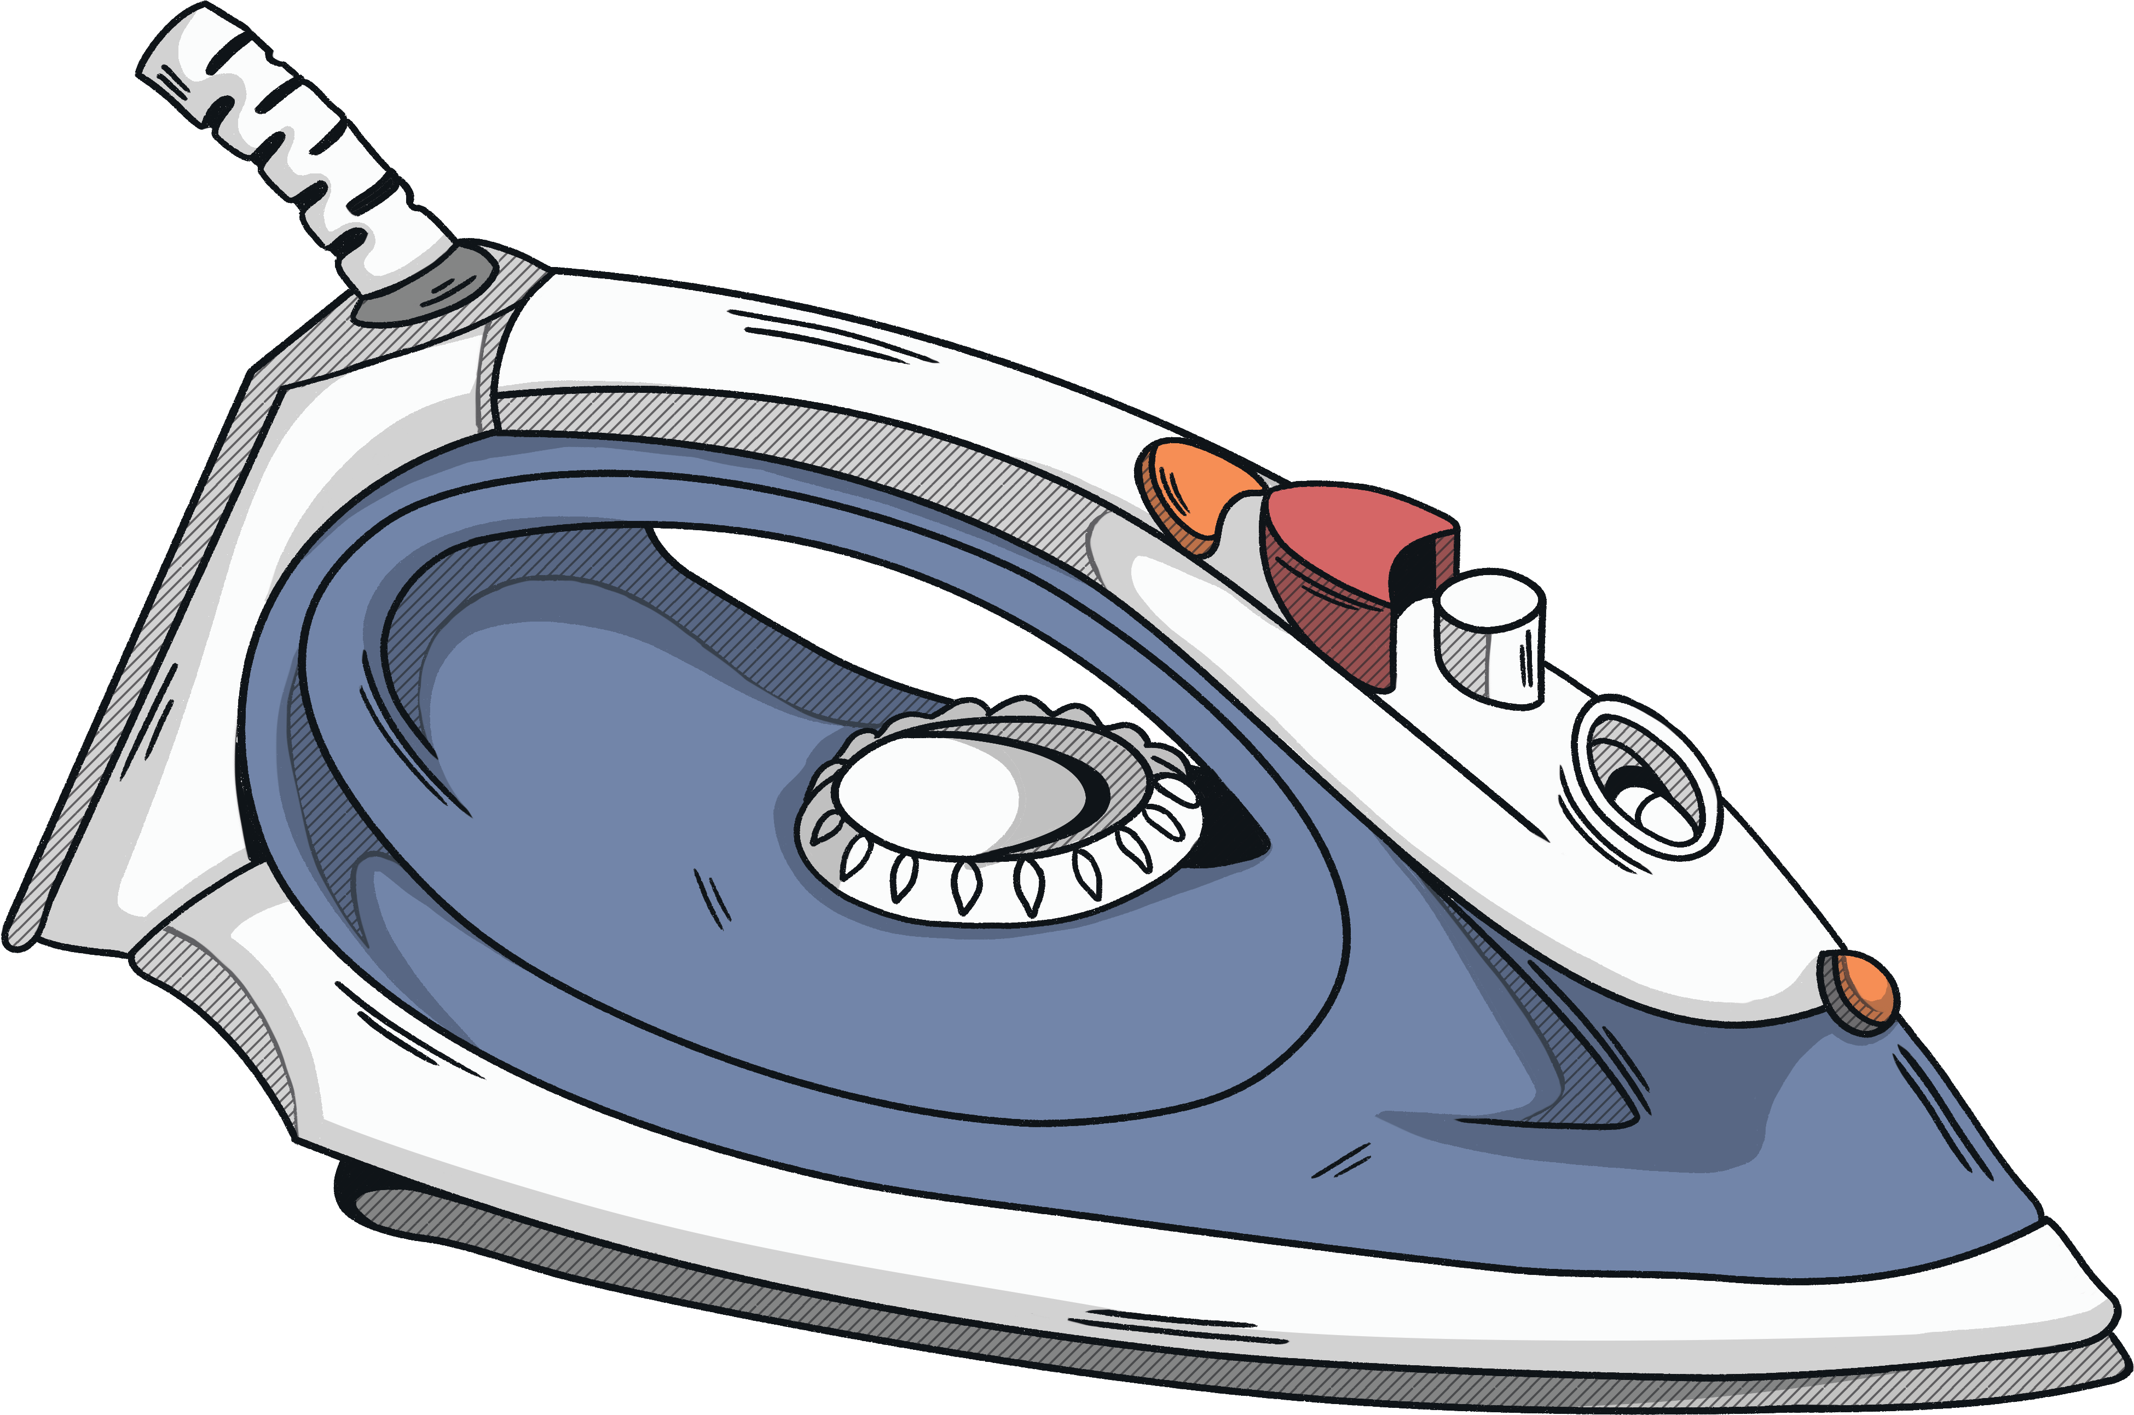
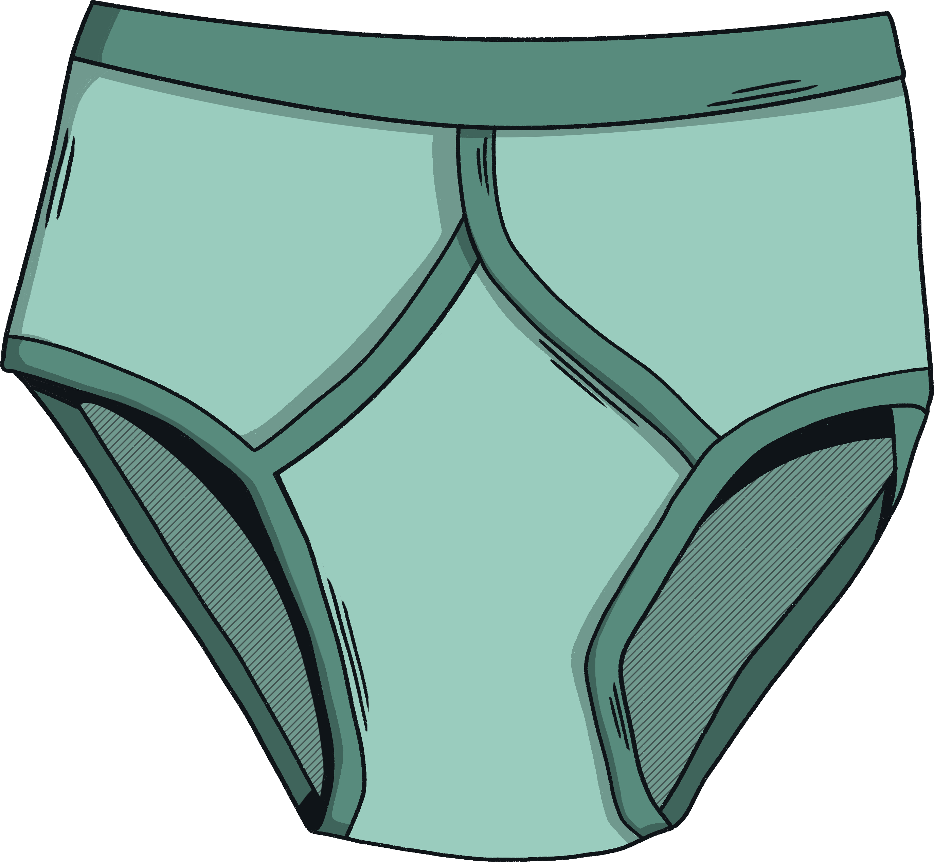
Ironing
Irene's Ironing
Service
£2.78 per shirt
85p per pair of pants
Show how much Irene will charge to iron:
5 shirts
13 shirts and 3 pairs of pants
27 pairs of pants and 10 shirts
If Irene received £13.60 just for ironing pants, how many pairs did she iron?

Slide 10
Ironing Answers
Irene's Ironing
Service
£2.78 per shirt
85p per pair of pants
Show how much Irene will charge to iron:
5 shirts
13 shirts and 3 pairs of pants
27 pairs of pants and 10 shirts
5 × 2.78 = £13.90
13 × 2.78 + 3 × 0.85 = £38.69
27 × 0.85 + 10 × 2.78 = £50.75
If Irene received £13.60 just for ironing pants, how many pairs did she iron?
13.60 ÷ 0.85 = 16

Slide 11

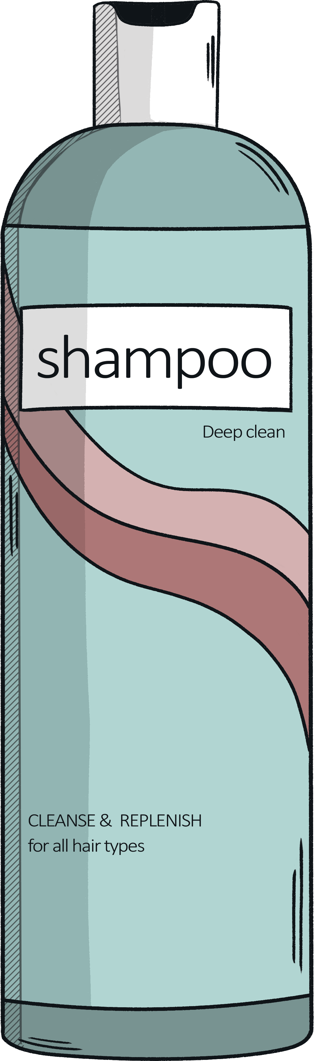
Toiletries
Calculate the total cost and the change you would get from a £5 note if you bought:
Moisturiser and deodorant
Shower gel and soap
Handwash and two deodorants
Shower gel
Deodorant
Handwash
Soap
Moisturiser
83p
£1.12
79p
36p
£1.90

Slide 12
Toiletries Answers
Calculate the total cost and the change you would get from a £5 note if you bought:
Moisturiser and deodorant
  1.90 + 1.12 = £3.02
  Change: 5 – 3.02 = £1.98
Shower gel and soap
  83 + 36 = 119p = £1.19
  Change: 5 – 1.19 = £3.81
Handwash and two deodorants
  0.79 + 2(1.12) = 0.79 + 2.24 = £3.03
  Change: 5 – 3.03 = £1.97
Shower gel
Deodorant
Handwash
Soap
Moisturiser
83p
£1.12
79p
36p
£1.90

Slide 13
Your Turn
Add the your own values to the student-led practice sheets:
Bread: £______; Milk: £______; Eggs: £______; Steak: £______;
Mugs: £______;
Item | Cost per item | Quantity | Total Cost
Tin of paint | £ ____________ | ______ | £ ____________
Skirting board | £ ____________ | ______ | £ ____________
Interior door | £ ____________ | ______ | £ ____________
Plug socket | £ ____________ | ______ | £ ____________
Total |  |  | £ ____________
Dave charges £______ an hour for labour and the job took him _____ hours.

Slide 14
Your Turn
£______ per shirt; _______ per pair of pants.
  _____ shirts
  _____ shirts and ______ pants
  _____ pants and ______ shirts
  Irene received £______ just for ironing pants.
Shower gel: £______; Deodorant: £______; Handwash: £______; Soap: £______; Moisturiser: £______.

Slide 15
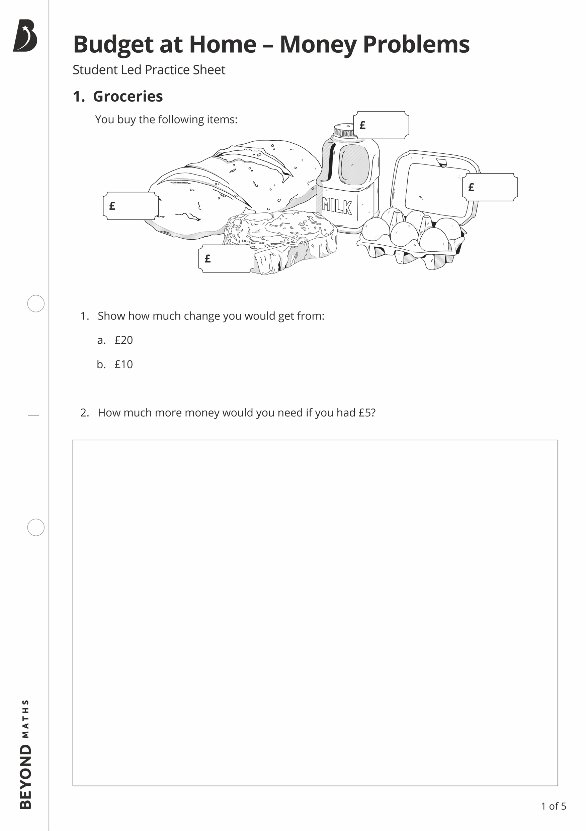
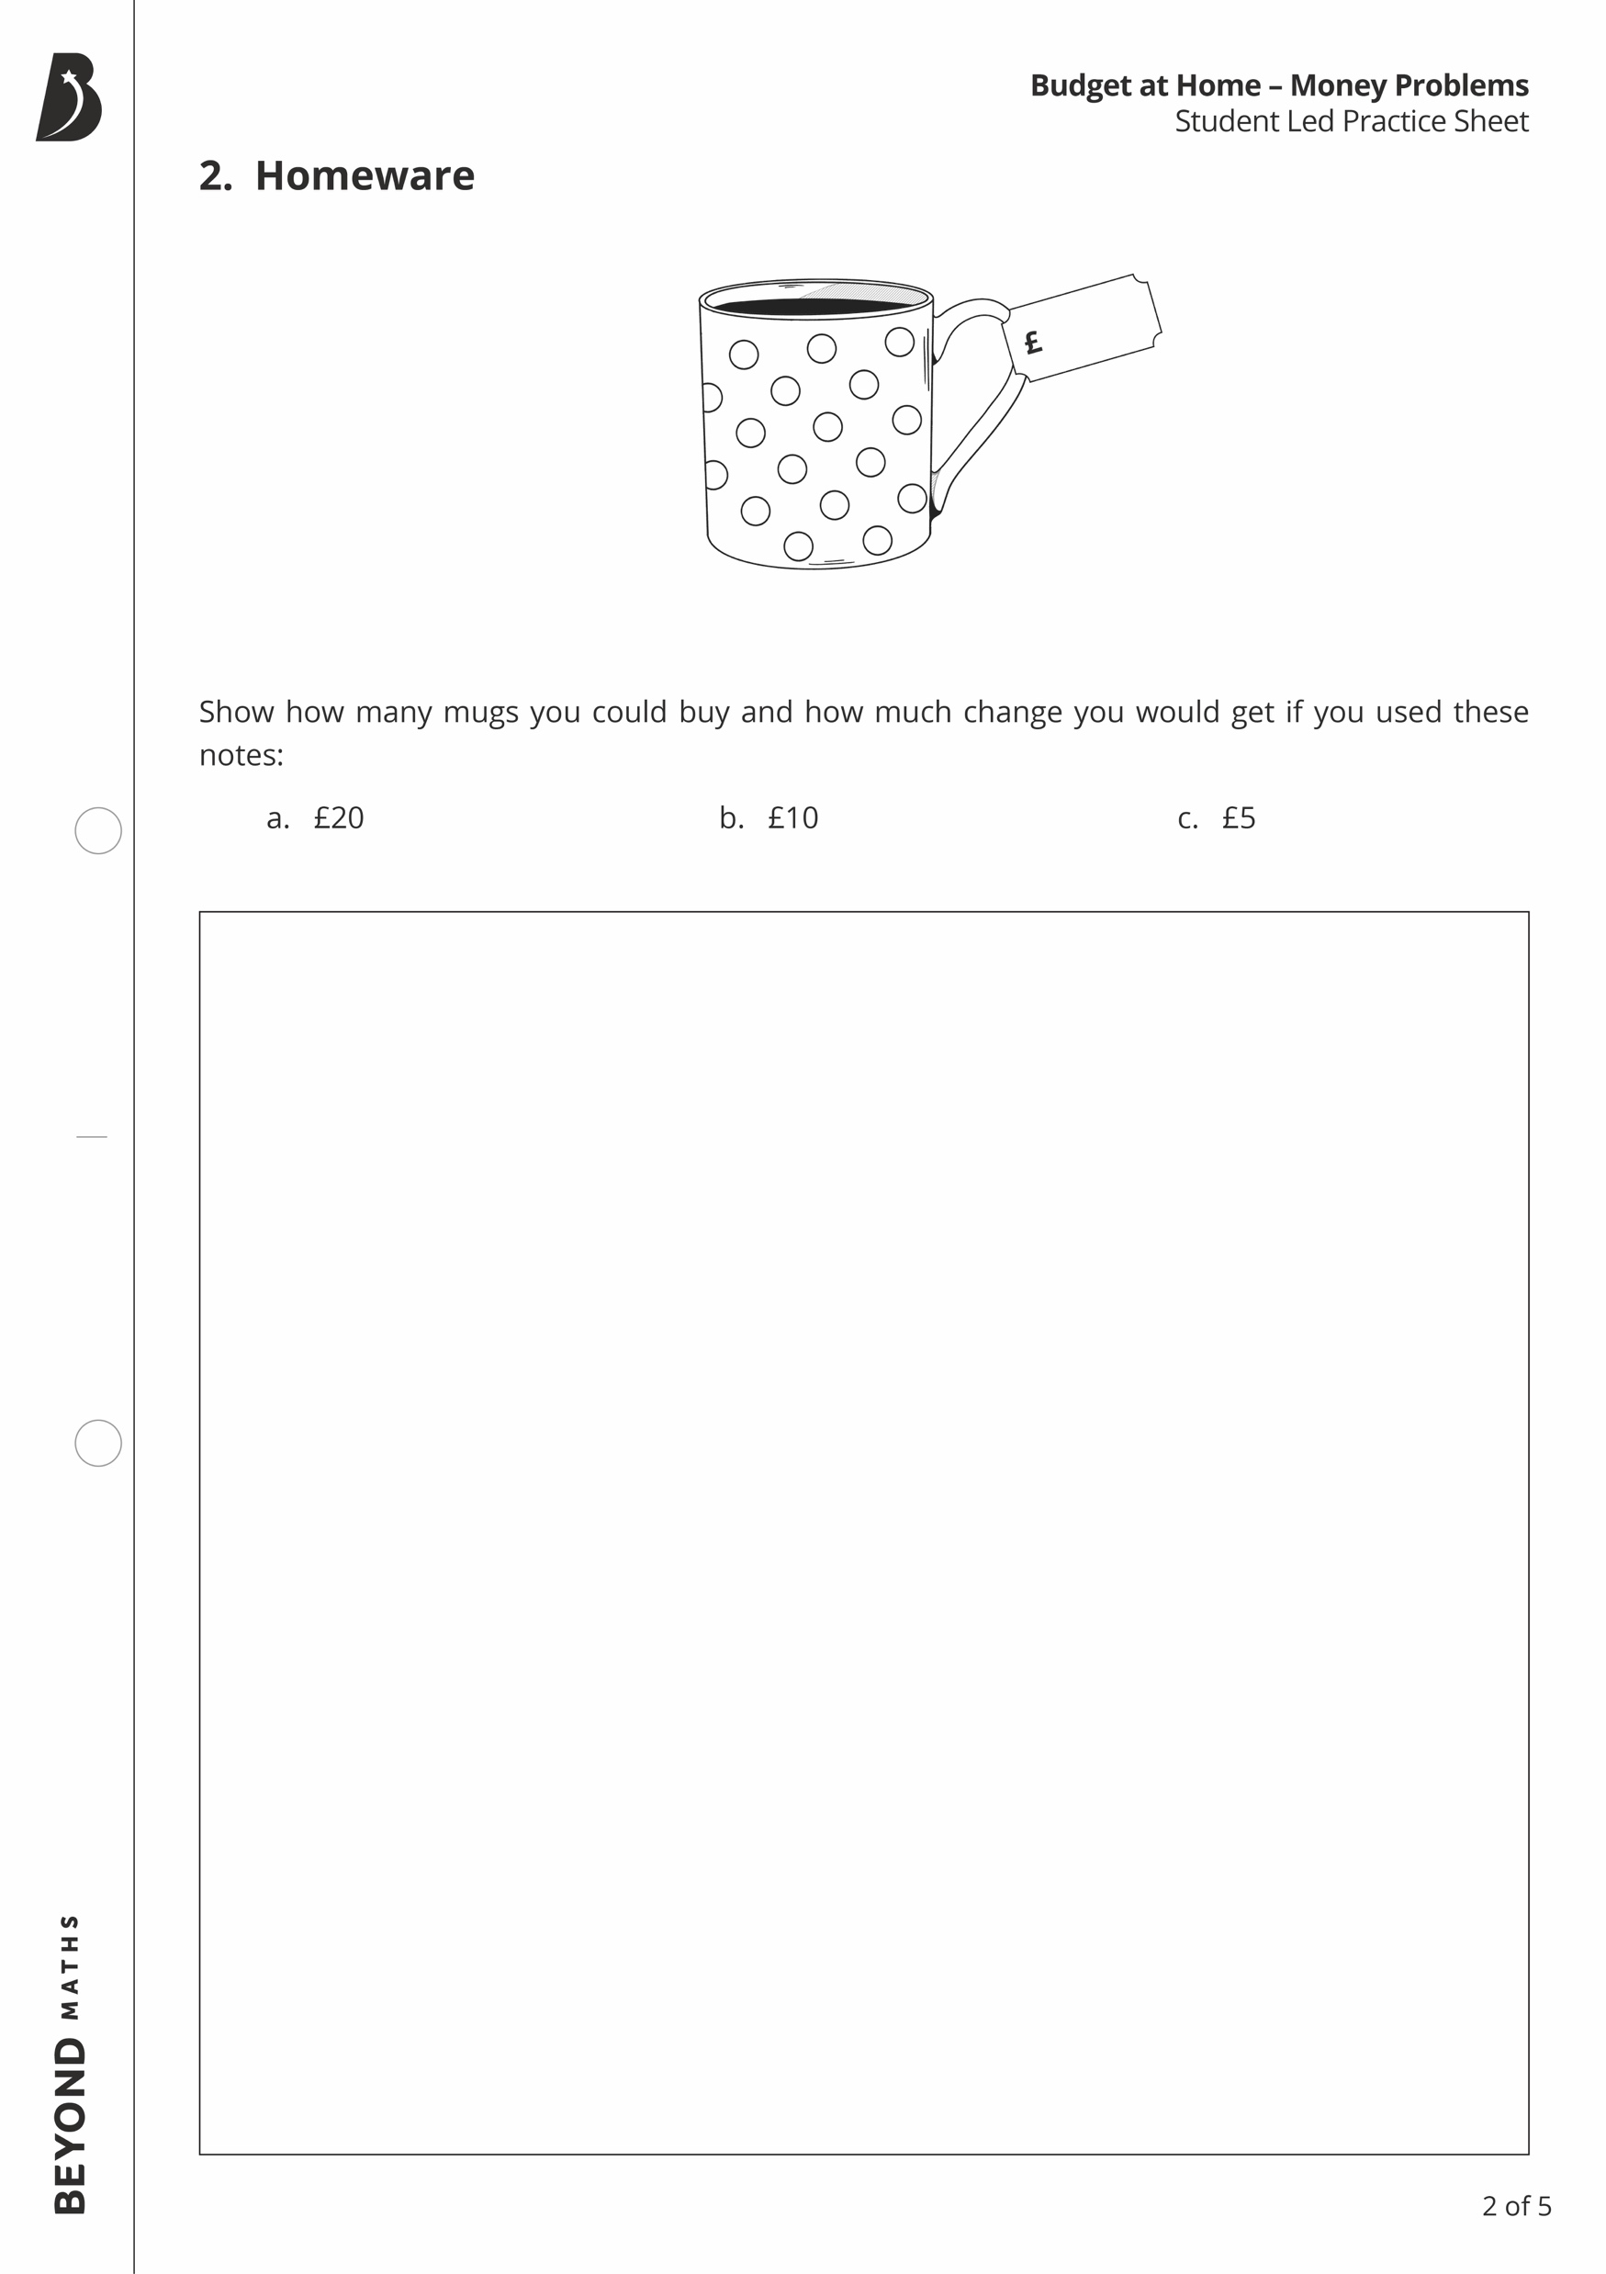
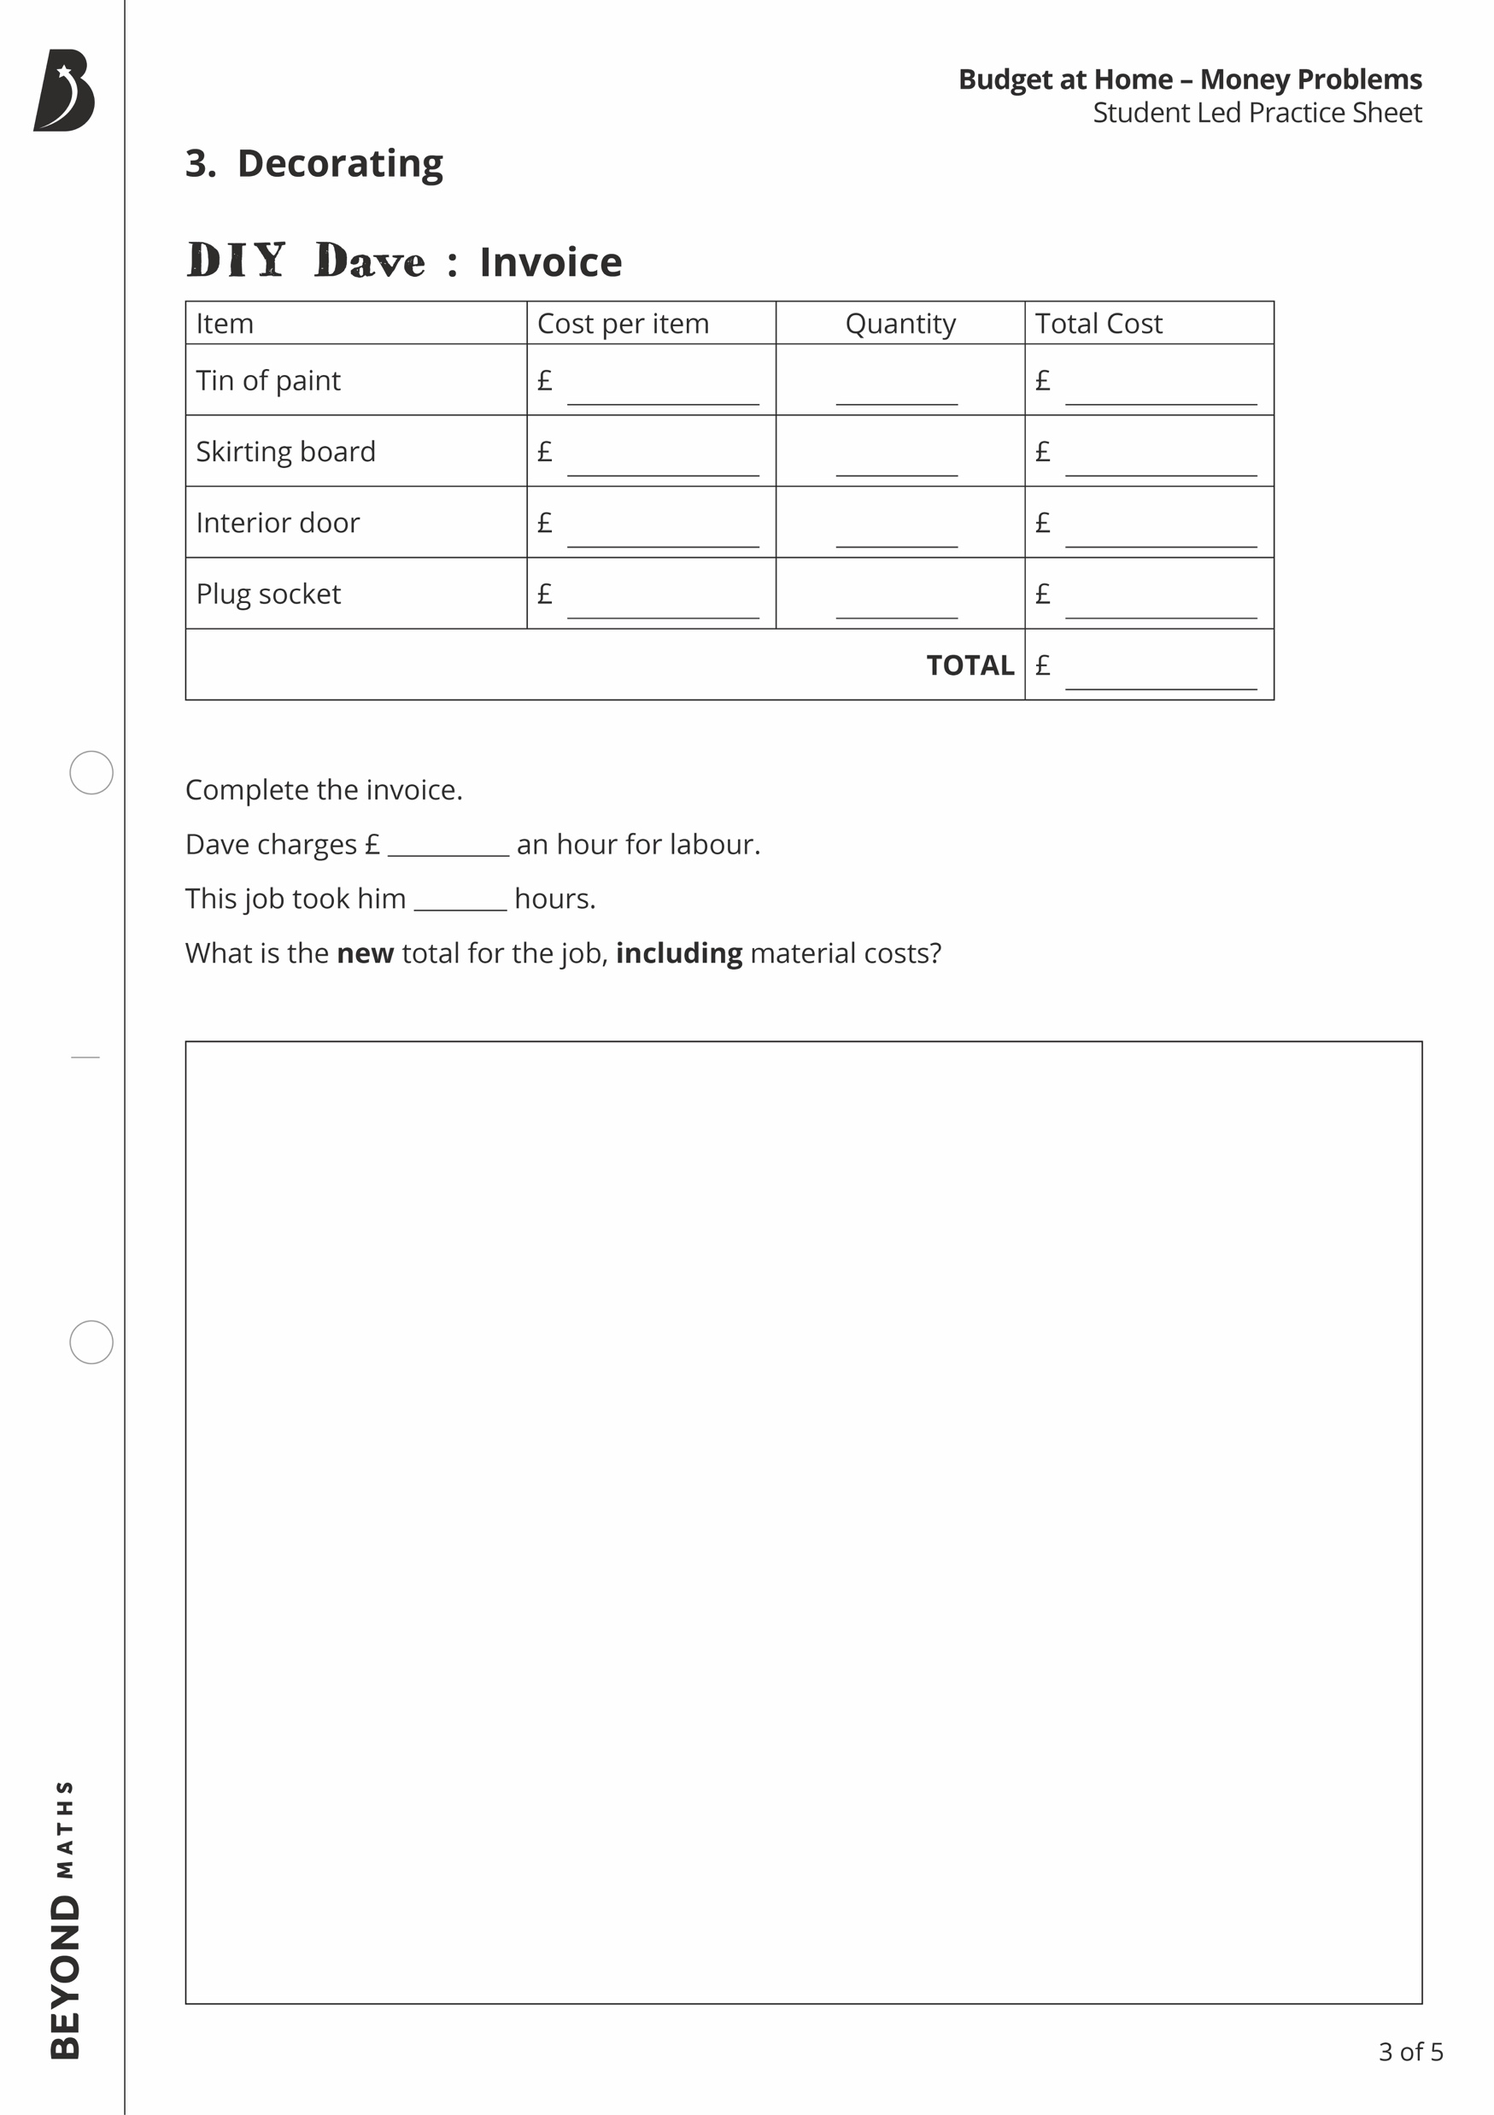
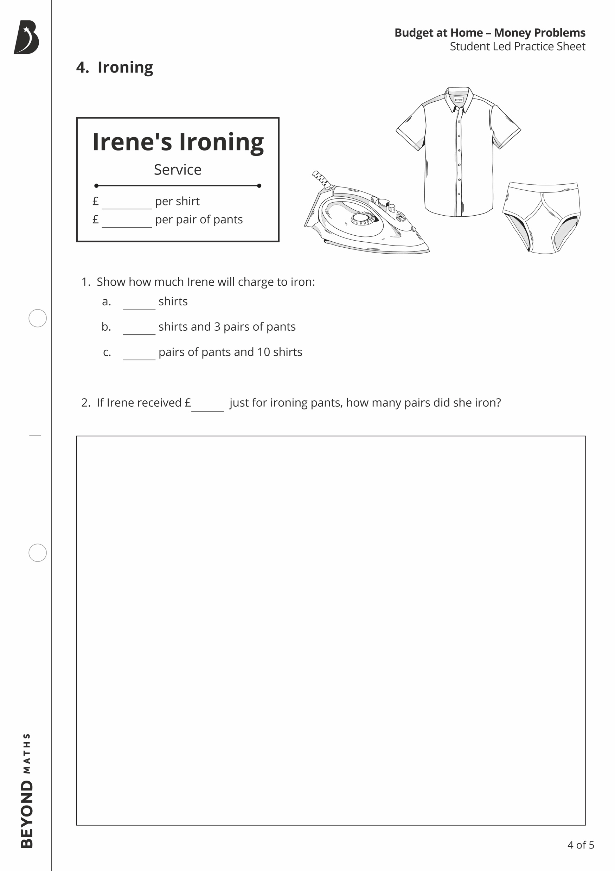
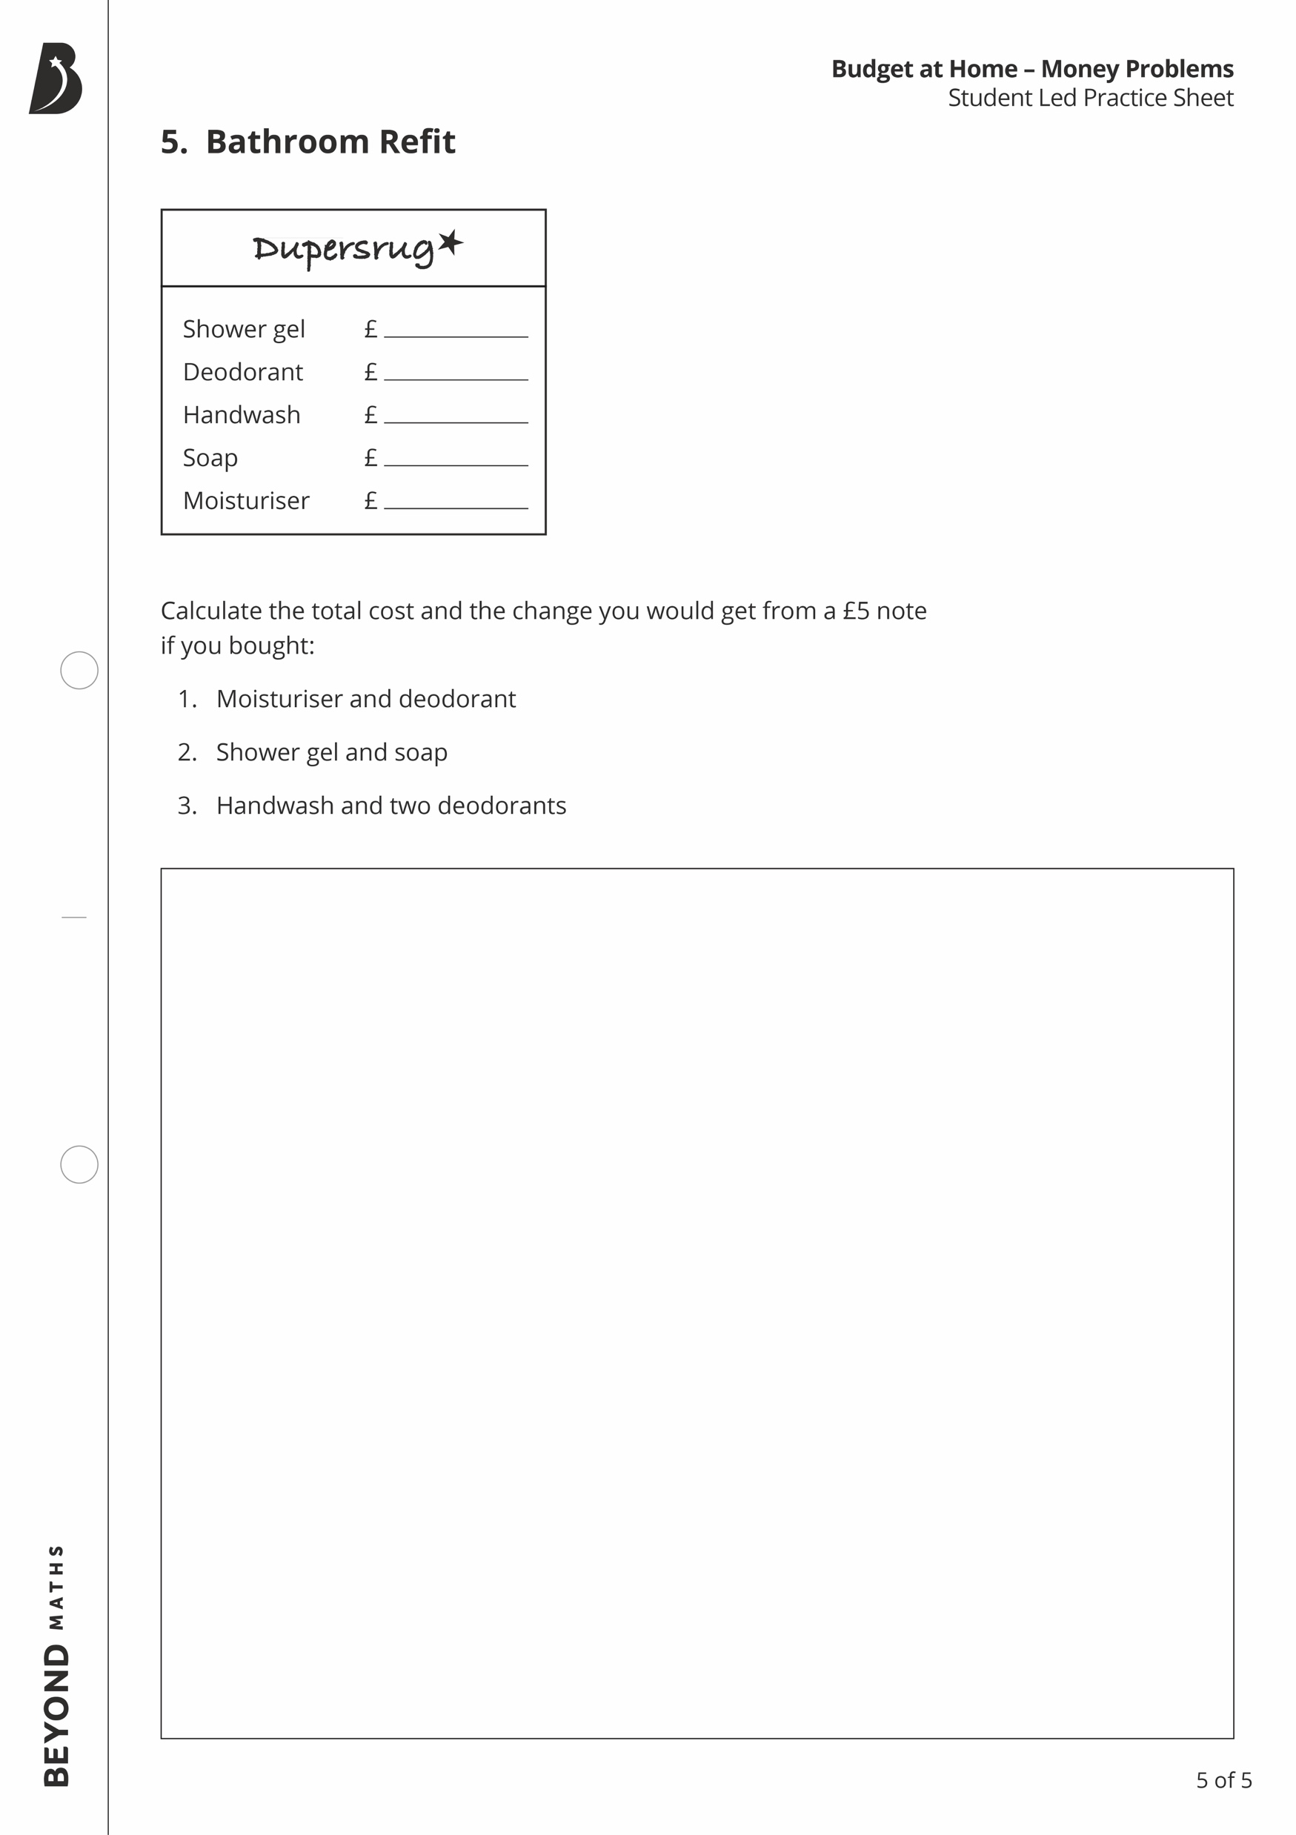
Your Turn

