Slide 1
Disclaimer/s
We hope you find the information on our website and resources useful.
Animations
This resource has been designed with animations to make it as fun and engaging as possible. To view the content in the correct formatting, please view the PowerPoint in ‘slide show mode’. This takes you from desktop to presentation mode. If you view the slides out of ‘slide show mode’, you may find that some of the text and images overlap each other and/or are difficult to read.
To enter slide show mode, go to the slide show menu tab and select either from beginning or from current slide.

Slide 2


History
Ancient Greece
Year One
History | Ancient Greece | Who Were the Ancient Greeks? | Lesson 1

Slide 4

Question Marks
You will spot question marks at certain points in
this Lesson Presentation.
Clicking the question marks
will bring up key questions.
The assessment questions that appear will enable you to check your understanding against the lesson aim and success criteria.

Slide 5
Aim
To explore some of the key events during the ancient Greek period.
Success Criteria
I can use and understand the terms ‘trade’, ‘civilisation’ and ‘chronologically’.
I can discuss when the ancient Greek period was in relation to other periods in world history.
I can order key events chronologically during a period in history.

Slide 6
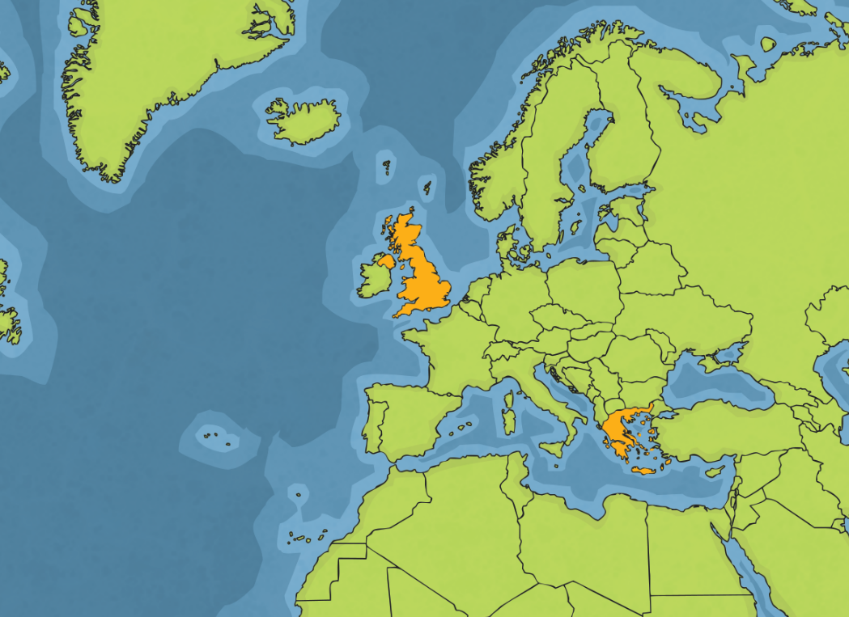
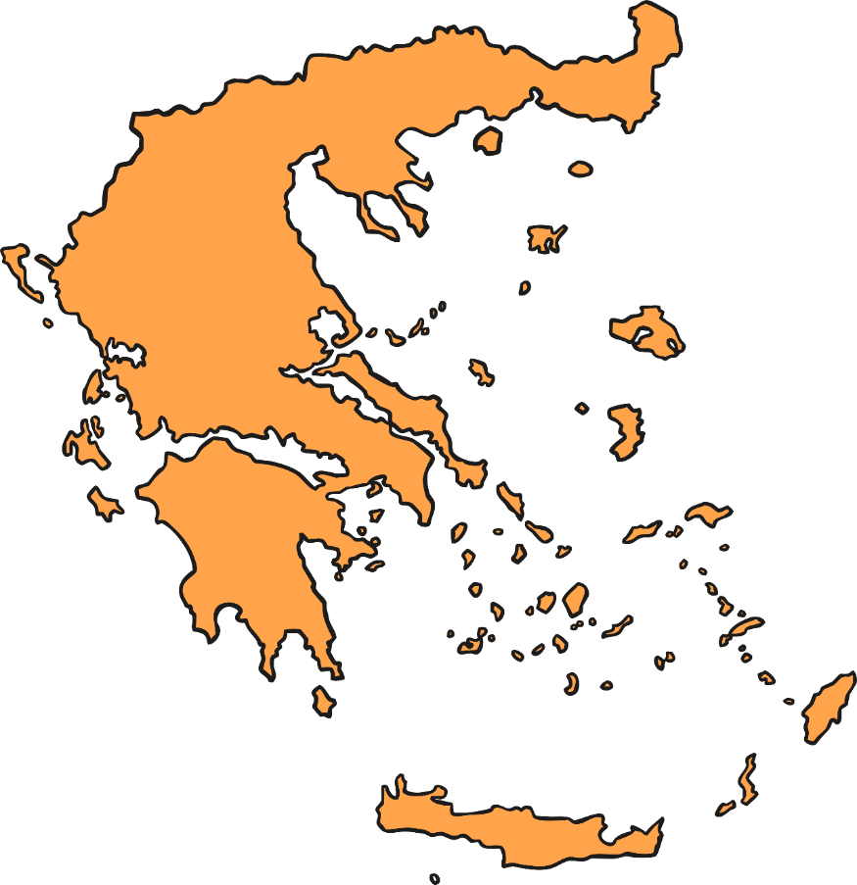
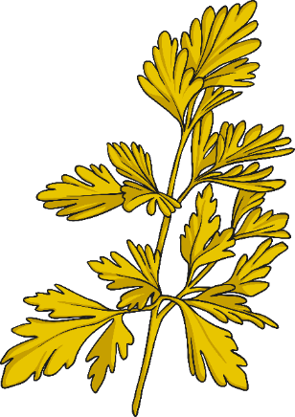

X
Remember It
Where Is Modern Greece?
Click on the circle to zoom.
What do you know about Greece?
Tell your partner anything you know about modern Greece.

Slide 7




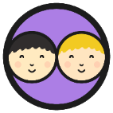



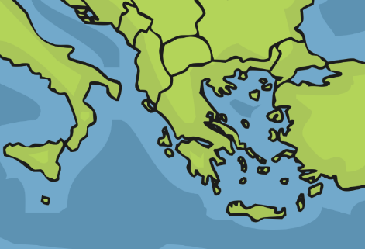


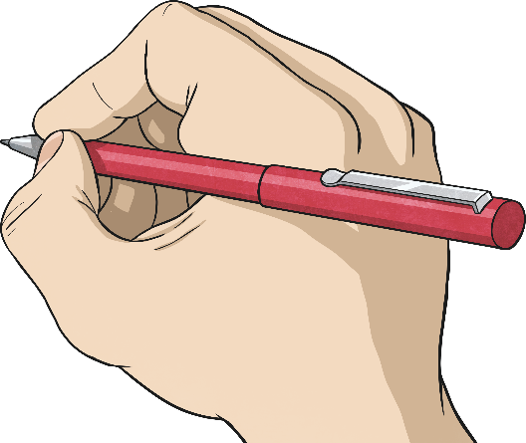
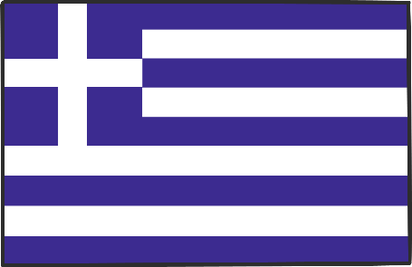
Remember It
What things did you already know?
Greece has borders with Albania, Bulgaria,
North Macedonia and Turkey.
Greece has the longest coastline in Europe
and the mainland is mostly mountains.
Greece has over 1000 islands. The largest of these is Crete.
The warm climate and proximity to the coast help
to make Greece a popular holiday destination.
Athens is the capital of Greece.
Athens
Crete

Slide 8

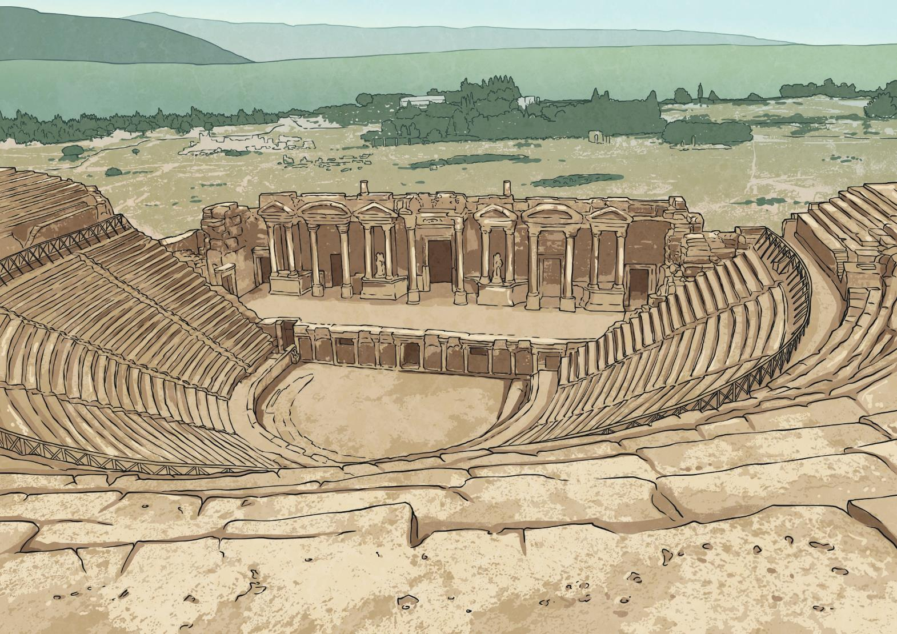
What Do We Know about Ancient Greece?
What do you already know about ancient Greece?
The dates we will be learning about regarding ancient Greece all end in the letters BC.
Do you know what BC stands for?
BC stands for Before Christ and refers to any date before the year Christians believe Jesus was born. The Romans who introduced this calendar had no symbol for zero and the year that Jesus was born was called Year 1.
Some dates use BC and some use AD.
AD stands for Anno Domini and is a medieval Latin phrase that means, ‘In the year of our Lord’. AD is used for dates after the point Christians believe Jesus was born.
Notes:
Additional Subject Knowledge Notes: Sometimes you will see BC called BCE (Before Common Era) and sometimes AD is called CE (Common Era). Common Era’ means the time from Year 1 onwards or 'a year in our time', e.g. 2021 CE or AD 2021 which we would just say is the year 2021. These can be used as non-religious alternatives. BC and AD have been used in the throughout this unit to be in line with the national curriculum.

Slide 9

What Do We Know about
Ancient Greece?
You may find it surprising to learn that ancient Greece was not a country.
It was a civilisation made up of city states. Another way of saying city state is ‘polis’ which means city in Greek.
In this context, the word ‘civilisation’ is used to describe a human society with well-developed rules and a government. Technology and the arts are often considered important.
What other civilisations have you learnt about?
X
Can you explain what ‘civilisation’ means?

Slide 10
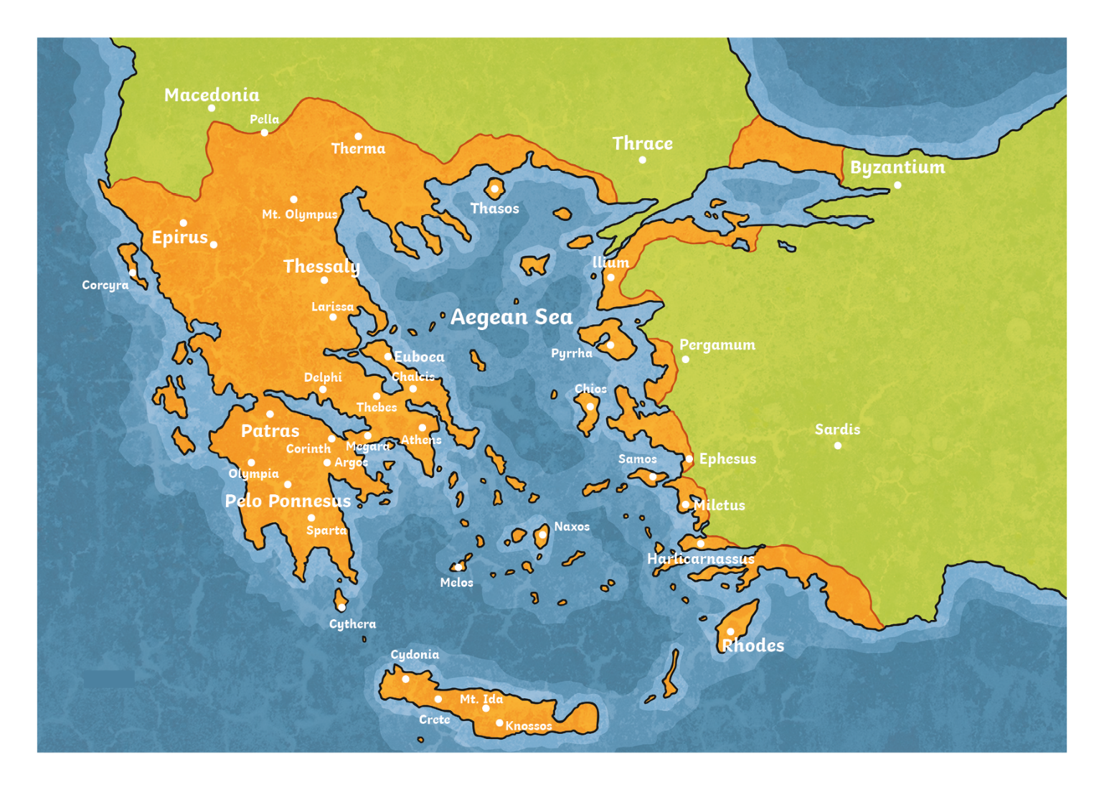
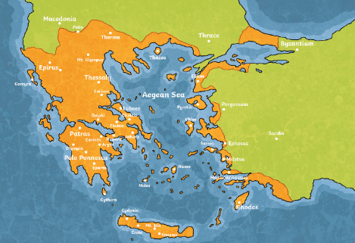

X
What Do We Know about
Ancient Greece?
You may find it surprising to learn that ancient Greece was not
a country.
It was made up of city states. Another way of saying city state is ‘polis’ which means city in Greek.
These city states made their own rules and lived alongside one another. Often there were battles between
these city states but sometimes they would
join together against a common enemy.
Important city states of ancient Greece
included Athens, Corinth and Sparta.
Map showing ancient Greece around 750 BC
Click on the map to zoom!

Slide 11
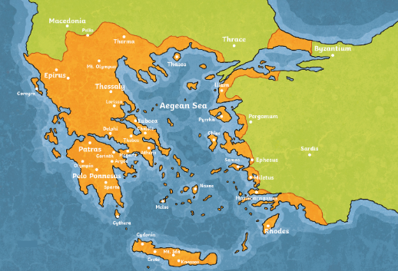
What Do We Know about
Ancient Greece?
You will notice that many of the settlements in Greece – in modern times and in ancient times – are near the sea. Why do you think this might be?
Settlements developed along the coast as the sea provided a good source of food and allowed them to trade with people from other countries and city states.
To trade means to exchange (or to buy and sell) objects or services with others.
What sorts of things might the ancient Greeks have traded?
X
Can you explain what ‘trade’ means?
Notes:
Additional Subject Knowledge Notes: The sea was a means for people to travel and trade with other city states and countries. The mountains in Greece made it very difficult to move around and trade with other settlements by land.

Slide 12

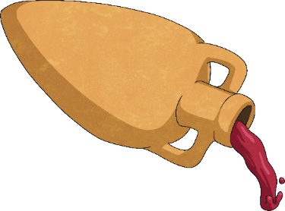
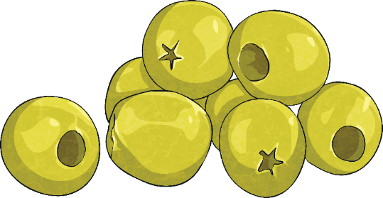
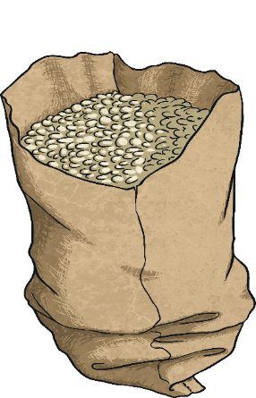
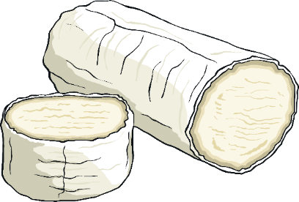
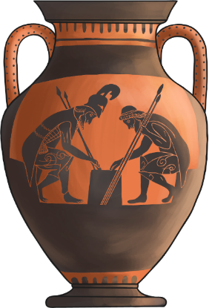
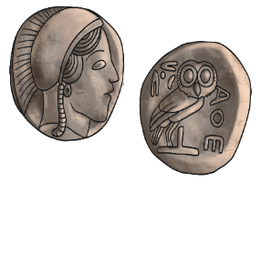
What Do We Know about
Ancient Greece?
Items that the city states traded between one
another and with other countries included:
wine
olives
grain
From around 600 BC, the ancient Greeks used coins to trade with.
cheese
pottery

Slide 13
Ancient Greece in Time
Where does ancient Greece fit in with some of the other periods in history that you may have learnt about? What do you notice about ancient Greece in comparison to other periods?
Timeline
3500 BC
AD 1
AD 1500
Ancient Egypt
Ancient Rome
Maya Civilisation
Ancient Greece
Celtic Britain
Anglo-Saxon Britain
X
Can you discuss when ancient Greece was in relation to other periods in history?
Notes:
Additional Subject Knowledge Notes: Evidence has been found of people living in Greece before 7000 BC but we will be focussing on ancient Greece in around the 1000 years before the Year 1. Some historians consider the ancient Greek period to have ended around 146 BC when the Romans took control of Greece and this timeline indicates around 146 BC as being the end of this period. However, some historians think of the end of the ancient Greek period as being when Alexander the Great died in 323 BC.

Slide 14

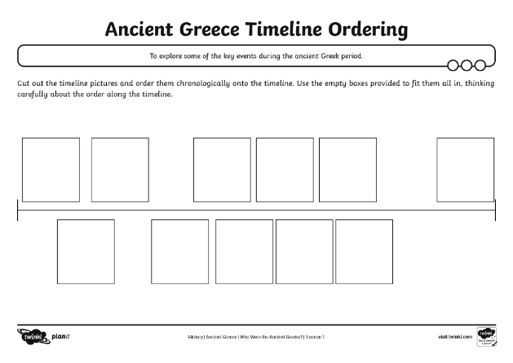
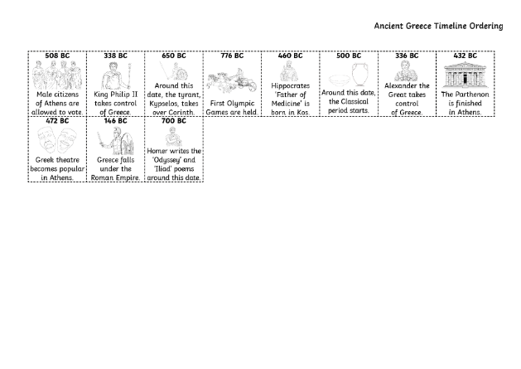
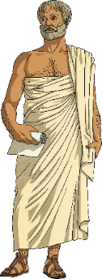
Ordering Events Chronologically
You will chronologically order some important events from ancient Greek times using the Ancient Greece Timeline Ordering Activity Sheet.
Cut out the timeline pictures and order them chronologically onto the timeline.
Chronologically means the order in which the events happened.
X
Can you explain what ‘chronologically’ means?
Notes:
Additional Subject Knowledge Notes: Children may be interested to know that the origin of the word ‘chronologically’ comes from the ancient Greek word ‘khronos’ meaning time. The Timeline Events Sheet includes some information about the Parthenon. The controversy around the Parthenon marbles, which were taken from the Parthenon by Lord Elgin and sold to the British Museum and still remain there, may be something the class wishes to explore further as part of this lesson.

Slide 15







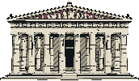

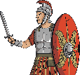

Ordering Events Chronologically
508 BC
338 BC
650 BC
776 BC
460 BC
500 BC
336 BC
432 BC
Around this date, the tyrant, Kypselos, takes over Corinth.
Hippocrates ‘Father of Medicine’ is born in Kos.
Alexander the Great takes control of Greece.
Male citizens of Athens are allowed to vote.
King Philip II takes control
of Greece.
Around this date, the Classical period starts.
The Parthenon is finished
in Athens.
First Olympic Games are held.
472 BC
146 BC
700 BC
X
Can you order key events chronologically?
Greek theatre becomes popular
in Athens.
Greece falls under the Roman Empire.
Homer writes the 'Odyssey' and 'Iliad' poems around this date.

Slide 16
Ancient Greece’s Influence
Ancient Greece is important because many things in culture today, especially in modern Europe, have been influenced by the ideas of the ancient Greek civilisation.
In the following lessons, we will be learning about ancient Greek culture.
Notes:
Additional Subject Knowledge Notes: The sculptures, architecture, philosophy, politics and the scientific and mathematical ideas of ancient Greece are just some of the things that have had a significant impact on culture today.

Slide 17
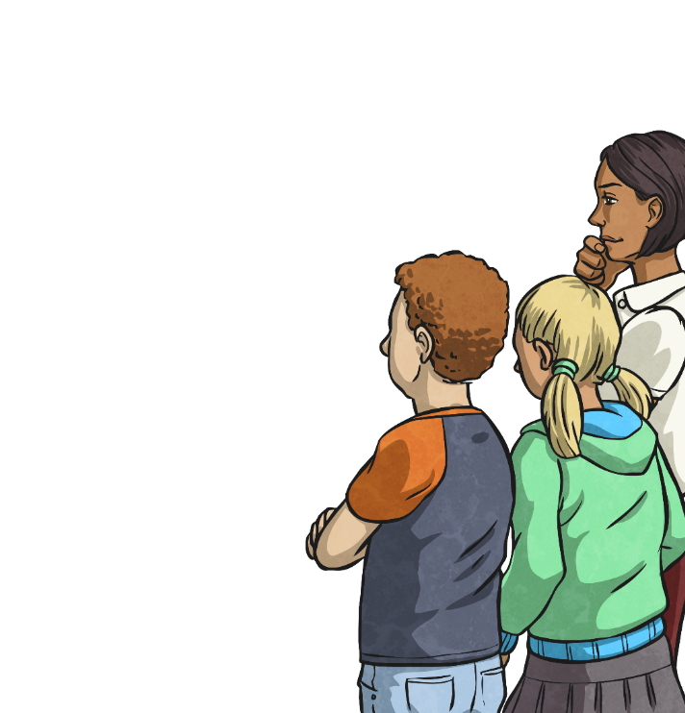


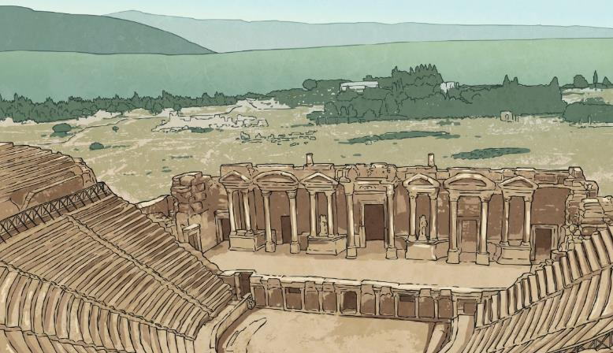
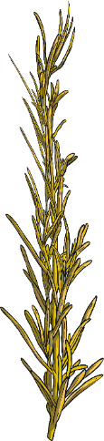
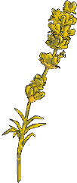
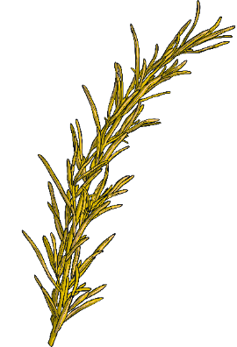
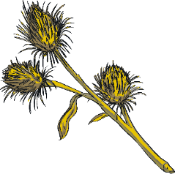


Asking Questions
Write down a question for your partner to answer about something that you have learnt about ancient Greece in today’s session.
When you are both ready, ask each other the questions that you have written down.
What else would you like to know about ancient Greece? Think of a question and share it with your partner.
Notes:
Additional Subject Knowledge Notes: The sculptures, architecture, philosophy, politics and the scientific and mathematical ideas of ancient Greece are just some of the things that have had a significant impact on culture today.

Slide 18
Aim
To explore some of the key events during the ancient Greek period.
Success Criteria
I can use and understand the terms ‘trade’, ‘civilisation’ and ‘chronologically’.
I can discuss when the ancient Greek period was in relation to other periods in world history.
I can order key events chronologically during a period in history.

