Slide 1
Vampires
Pop Culture

Slide 2
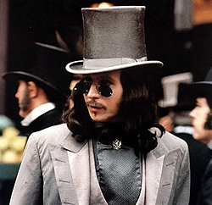
Vampires In Movies
Bram Stoker’s Dracula

Slide 3

Vampires In Movies
Twilight

Slide 4
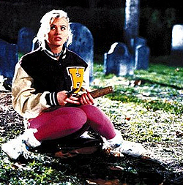
Vampires In Movies
Buffy The Vampire Slayer

Slide 5
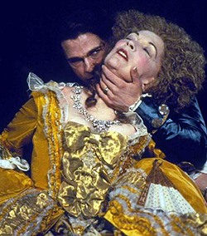
Vampires In Movies
Interview With A Vampire

Slide 6
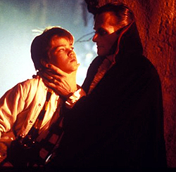
Vampires In Movies
Monster Squad

Slide 7
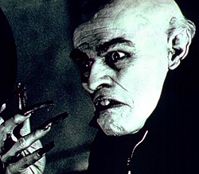
Vampires In Movies
Shadow Of A Vampire

Slide 8
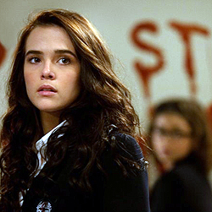
Vampires In Movies
Vampire Academy

Slide 9


Vampires In Books

Slide 10


Vampires In Books

Slide 11


Vampires in books

Slide 12

Vampires On Television
Buffy The Vampire Slayer

Slide 13

Vampires on Television
Disney’s My Babysitter’s A Vampire

Slide 14

Vampires On Television
The Originals

Slide 15
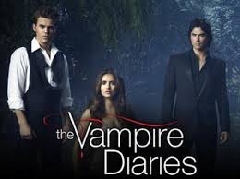
Vampires On Television
The Vampire Diaries

